Slide 1
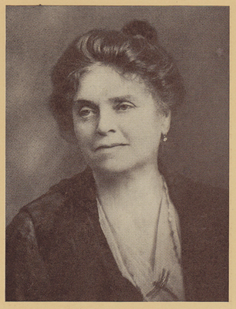
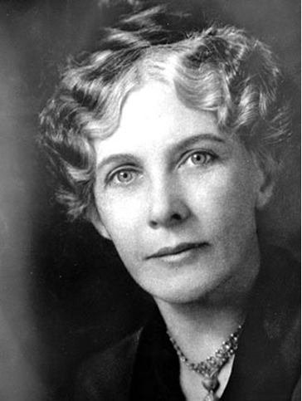
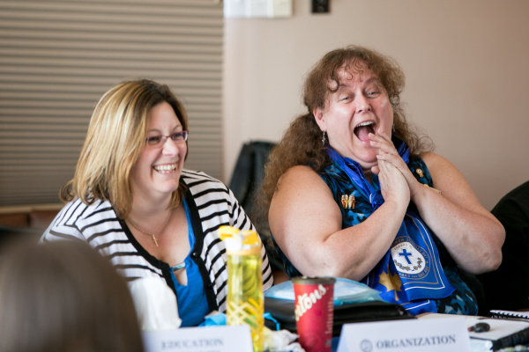
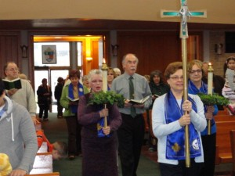
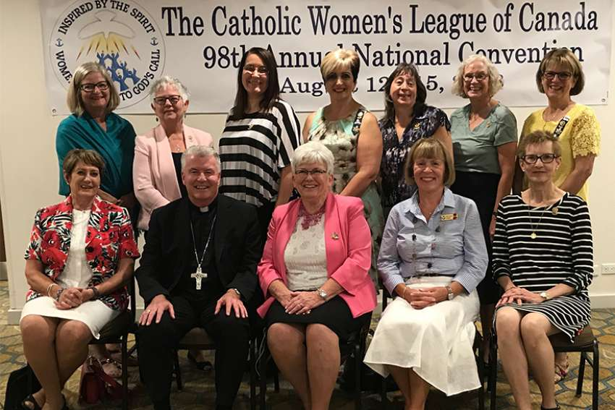
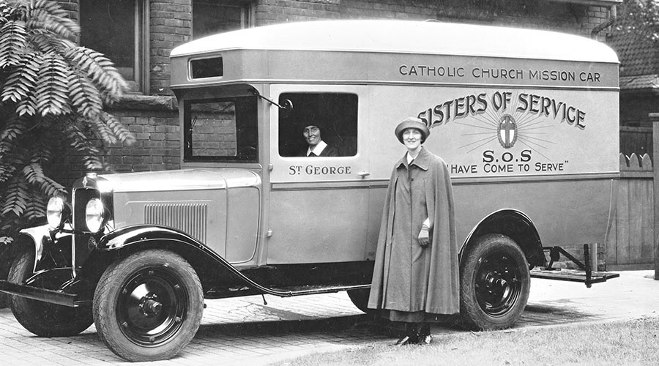
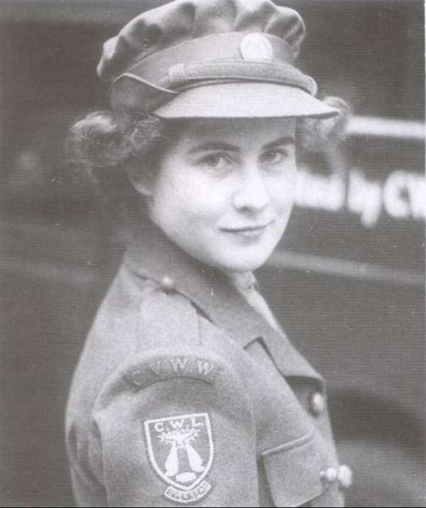
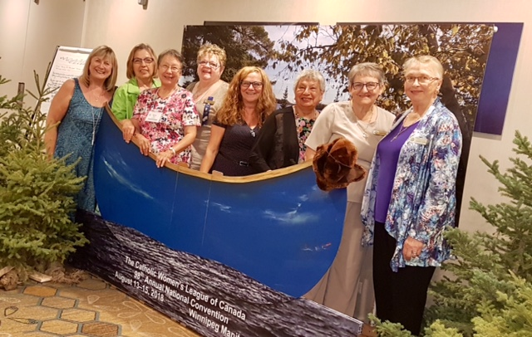
The Centenary Committee invites you to look into your archives for pictures of memorable CWL events that happened in your parish, diocese or province over the past 100 years.
Bring your pictures to the national convention in 2020 and they will be put on display for the
duration of the convention.
The Centenary Committee will be choosing
pictures to be included in the
100th Anniversary Commemorative
Coffee Table Book.
We can’t wait to see your pictures that
capture and celebrate
the past 100 years!

