Slide 1
The Call to Not Commodify: A Conversation on Relationships
Timothy Harvie, phd, licdd
Cwl National convention, August 2019
DISCLAIMER
The views expressed in this presentation do not necessarily reﬂect the views of The Catholic Women’s League of Canada.

Slide 2
When we think about relationships, who comes to mind?

Slide 3
What kinds of relationships are we talking about today?
Our relationships with each other.
Our relationship with the earth.
Our relationships with institutions and structures.

Slide 4
What does the economy have to do with relationships?
It is a tool to help people live.
It arranges how society conducts itself.
It arranges how people relate to themselves, to others, and to things we need (goods).

Slide 5
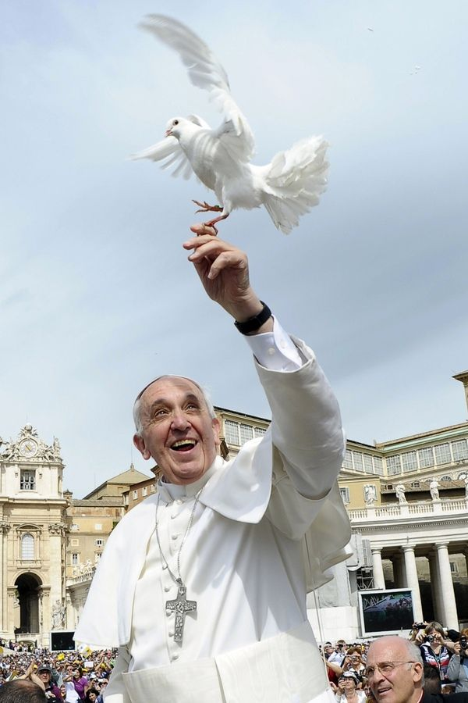
Pope Francis’s “Laudato Si’” is all about forging healthy relationships

Slide 6
Pope Francis’s “Laudato Si’” is all about forging healthy relationships (no. 66)
With God (prayerfully)
With others (economically)
With creation (ecologically)

Slide 7
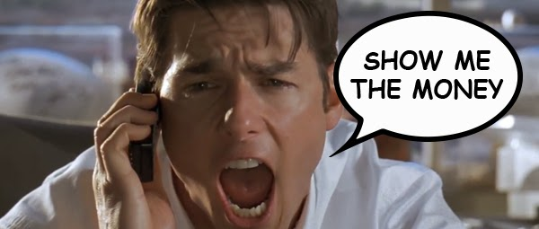
A little bit about the economy…
Two central claims:
Economics is a neutral discipline, objective like science
Growth is necessary for a healthy economy

Slide 8
World Bank: The Growth Report (2008)
Growth is measured by the Gross Domestic Product (GDP)
“A growing GDP is evidence of a society getting it collective act together.”

Slide 9
World Bank: The Growth Report (2008)
Growth is measured by the Gross Domestic Product (GDP)
“A growing GDP is evidence of a society getting it collective act together.”
This is one version of development. The Catholic Church talks about another version.

Slide 10
“[A] great effort must be made to enhance mutual understanding and knowledge, and to increase the sensitivity of consciences…Creating such conditions calls for a concerted worldwide effort to promote development, and effort which also involves sacrificing the positions of income and of power enjoyed by the more developed economies. This may mean making important changes in established life-styles, in order to limit the waste of environmental and human resources, thus enabling every individual and all the peoples of the earth to have a sufficient share of those resources.”

Slide 11
“[A] great effort must be made to enhance mutual understanding and knowledge, and to increase the sensitivity of consciences…Creating such conditions calls for a concerted worldwide effort to promote development, and effort which also involves sacrificing the positions of income and of power enjoyed by the more developed economies. This may mean making important changes in established life-styles, in order to limit the waste of environmental and human resources, thus enabling every individual and all the peoples of the earth to have a sufficient share of those resources.” (Pope St. John Paul II, Centesimus Annus, 52)

Slide 12
“Today the subject of development is also closely related to duties arising from our relationship to the natural environment. The environment is God’s gift to everyone, and in our use of it we have a responsibility towards the poor, towards future generations and towards humanity as a whole.”

Slide 13
“Today the subject of development is also closely related to duties arising from our relationship to the natural environment. The environment is God’s gift to everyone, and in our use of it we have a responsibility towards the poor, towards future generations and towards humanity as a whole.” (Pope Benedict XVI, Caritas in Veritate, 48)

Slide 14
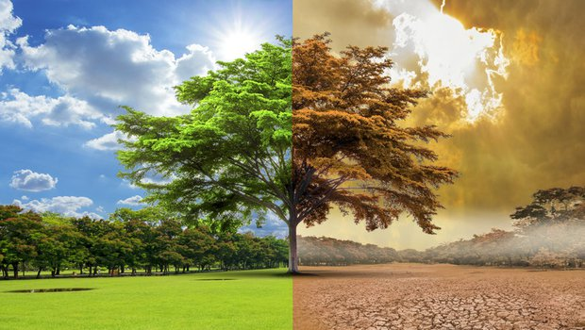
Care for others, especially the economically marginalized, and care for the earth are not just add-ons, but are central to Catholic faith and Catholic morality.

Slide 15
A little bit about the earth…
Intergovernmental Panel on Climate Change (IPCC)
242 lead authors
66 review editors from 70 countries
Surveyed more than 12,000 resources
Was approved line-by-line by panelists from 195 governments

Slide 16
A little bit about the earth…
Some of the IPCC findings:
Global temperature is on target to rise more than 4 degrees by the year 2100
Many animal species (land, freshwater, marine) have shifted their geographic range and behaviours due to climate
Agricultural regions will be heavily impacted, lowering crop yields
Uneven development leads to inequalities
Heat waves, wildfires and extreme weather increases will impact vulnerable people and human societies
People living in poverty are most affected
This results in increased violence and war

Slide 17
A little about the earth…
Findings from other studies:
By 2050 there will be more pieces of plastic in the oceans than fish
In my lifetime (I’m 43!) more than half of vertebrate wildlife has been lost due to human activity
We are currently losing animal and plant life at rates faster than the great mass extinctions (think about how the dinosaurs fared against meteors and volcanic eruptions)

Slide 18
So what does this have to do with economics?
Our current way of viewing things divides reality into two categories:
Humans
Things humans consume (we call them commodities)

Slide 19
So what does this have to do with economics?
John Locke (1632-1704)
Argued society is built upon the concept of property
Property is individual transforming nature through work (making it a commodity)
Therefore, society must commodify nature to be

Slide 20
So what does this have to do with economics?
St. Thomas Aquinas argued that our bodies set us in relationship with all things
This relationship is for the common good
So it is non-exploitative
Therefore, we may have property, but ownership is never an absolute right, since it is always with a view to our connection with others.

Slide 21
Laudato Si’
“The Christian tradition has never recognized the right to private property as absolute or inviolable, and has stressed the social purpose of all forms of private property.” (Pope Francis, Laudato Si’, 93)

Slide 22
Laudato Si’
“This is why the earth herself, burdened and laid waste, is among the most abandoned and maltreated of our poor.” (Pope Francis, Laudato Si’, 2)

Slide 23
Laudato Si’
“Each year sees the disappearance of thousands of plant and animal species which we will never know, which our children will never see, because they have been lost for ever. The great majority become extinct for reasons related to human activity. Because of us, thousands of species will no longer give glory to God by their very existence, nor convey their message to us. We have no such right.” (Pope Francis, Laudato Si, 33)

Slide 24
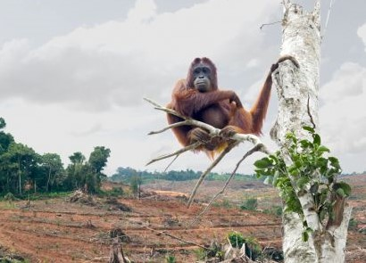
12 companies driving the extinction of orangutangs in the wild:
Colgate-Palmolive
General Mills
Hershey
Kellogg’s
Kraft-Heinz
L’Oreal
Mars
Mondelez
Nestle
PepsiCo
Reckitt Benckiser
Unilever

Slide 25
Laudato Si’
“Nobody is suggesting a return to the Stone Age, but we do need to slow down and look at reality in a different way, to appropriate the positive and sustainable progress which has been made, but also to recover the values and great goals swept away by our unrestrained delusions of grandeur.” (Pope Francis, Laudato Si, 114)

Slide 26
Laudato Si’
“We have only one heart, and the same wretchedness which leads us to mistreat an animal will not be long in showing itself in our relationships with other people.” (Pope Francis, Laudato Si’, 92)

Slide 27
The Thrust
Catholic faith sees a connection between how we relate to the earth, to each other, and to God. All three go together.

Slide 28
The Thrust
Catholic faith sees a connection between how we relate to the earth, to each other, and to God. All three go together.
Our current economy turns the earth and the living things in it into commodities for our consumption.

Slide 29
The Thrust
Catholic faith sees a connection between how we relate to the earth, to each other, and to God. All three go together.
Our current economy turns the earth and the living things in it into commodities for our consumption.
Pope Francis calls this a “throwaway culture.”

Slide 30
The Thrust
Catholic faith sees a connection between how we relate to the earth, to each other, and to God. All three go together.
Our current economy turns the earth and the living things in it into commodities for our consumption.
Pope Francis calls this a “throwaway culture.”
It is necessary to reorient our relationships

Slide 31
What can I do?
Ask questions about who benefits from our buying and selling, our extraction and resource use.
Investigate where our products come from.
Buy less, give more.
Fasting
Allow ourselves to be disrupted by others.

Slide 32
Disrupted by others.

Slide 33
Final Question:
When I seek to talk and act, when someone is telling me something they want me to believe about God, others, and the earth, what type of relationship is being nurtured?

