Slide 2
Prayer to Sustain
^{Lord, season after season,} You continue to renew the face of the earth, “For from the greatness and beauty of created things Comes a corresponding perception of their Creator.”
^{Teach us, Lord,} As members of The Catholic Women’s League of Canada, To become attuned to our need to protect ^{The beauty of our common home.}
May our efforts lead us to sustain its natural order, So that, in the words of Pope Francis, Our heritage is never “deprived of physical contact ^{with nature.”}

Slide 3
Creation
Creation is the foundation of “all God’s saving plans”, the “beginning of the history of salvation” that culminates in Christ… and reveals the end for which “in the beginning God created the heavens and the earth”, from the beginning God envisaged the glory of the new creation in Christ” (Catechism of the Catholic Church, 280).
The Creed:
“God, the Father, revealed as Creator of all that is seen and unseen;
Jesus Christ understood as One in whom all things are made;
The Holy Spirit understood as the Giver of Life. We cannot speak of the Trinity without considering… the boundless love of God for all creation” (John McCarthy SJ).
The Trinity of Ecology:
Father, we praise you with all your creatures.
Son of God, Jesus, through you all things were made.
Holy Spirit, you accompany creation as it groans in travail. (ibid)

Slide 4
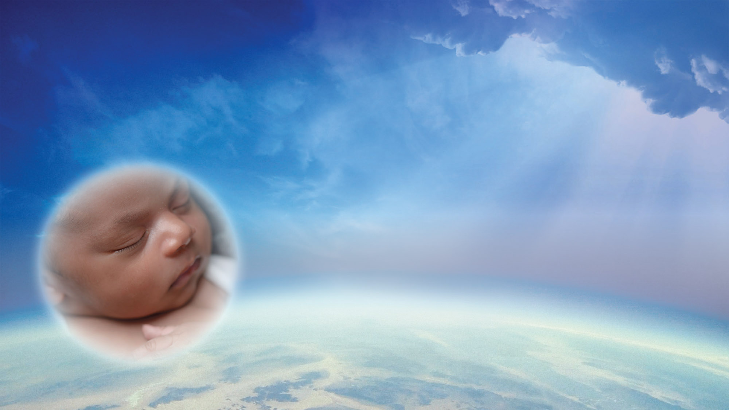
Human Creation
All creation is composed primarily of carbon, oxygen, hydrogen, and nitrogen.
The universe was created by God; all creation comes from God.
Theology listens to science; theology and science are compatible.
Earth and planets began to form around the sun about 4.5 billion years ago.

Slide 5
Pope Francis in Laudato Si…
“Praise be to you, my Lord, through our Sister, Mother Earth, who sustains and governs us, and who produces various fruit with coloured flowers and herbs” (Canticle of the Creatures, in Francis of Assisi: Early Documents. 1999, 113-114. In Laudato Si. 3).
Strategies for a solution [to environmental and social crises] demand an integrated approach to combating poverty, restoring dignity to the excluded, and at the same time protecting nature (Francis 94).
Nothing in this world is indifferent to us (ibid 3)

Slide 6
The Theme Message
God was revealed in the unique way through the incarnation of Jesus Christ. This has profound implications for the beauty and sacredness of all life, all matter.
All of creation, not just humans, long for fulfillment in the eternal life of God. The resurrection of Christ is the first sign and fruit of the promise of God for all creation. All creation longs for a new heaven and a new earth (Rev. 21:1).
The cry of the earth and the cry of the poor are one and the same.

Slide 7
Resources: Some Definitions
Climate change: a change in the earth’s climate, especially a change due to an increase in the average temperature
Commodity: a raw material that can be bought and sold
Compost: decayed organic material used as a plant fertilizer
Cosmic: vast; relating to the whole universe
Cosmic justice: the relief of all misfortune
Ecological conversion: concept introduced by Saint Pope John Paul II; becoming aware of and taking action; a worldwide movement
Ecology: the set of relationships existing between organisms and their environment
Ecosystem: a biological community of interacting organisms and their physical environment

Slide 8
Resources: Some Definitions
Environment: surroundings in which a person, animal or plant lives or operates
Intentional disciples: entrusting one’s life totally to Christ, and following Him
Natural resources: those things found in nature that are valuable to humans
Organism: a form of life considered as an entity; animal, plant, fungus…
Recycle: convert into reusable material
Re-purpose: adapt for a different use
Sustainable development: economic development without the depletion of natural resources and ecosystems
Theology: the study of the nature of God and religious belief

Slide 9
Resources: A Few Biblical References on which to Reflect…
Old Testament:
Gen 1:27,28-31; 2:15; 9:12-16
Ps 33:6; 36:6; 65:5-13; 98:7-9; 104:10-11,14-15,16-21,24,27-28,30; 136:6…
Prov 22:2 Lev 19:9-10; 25:1-4, 4-6
Wis 6:7; 7:26; 8:1 Book of Judith 16:14
New Testament:
2Cor 3:18, 4:4 Matt 1:18; Mark 1: 10:42-45
Luke 1:35 John 1:1-14;3:5; 4:17;6:63; 7:39; 14:16
Rom 8:11,21, 29; 1 Cor 8:6; 15:45, 49;
2Cor 13:13 Mark 1 15:35
Heb 1:2, 3

