Slide 1
The League of the Future
Year 5
August 2023

Slide 2
Notes:
Shari:
I have had the distinct fortune to be the liaison between the national executive/board and the implementation committee and working groups for the last two years.
As liaison, I tried to attend as many working group sessions as possible, all done online, and the implementation committee meetings as well, which were also attended by National President Fran Lucas, Executive Director Kim Scammell, Project Coordinator Kerri Sylvester as well as the three leads who will be introduced in a minute.
It is hard to believe, at least for me, that five years of strategic planning have elapsed! And plans are being made for the implementation and future mission.

Slide 3
Notes:
Shari:
We started this journey of evolution for the League in Prince Edward Island over five years ago with consultations, development discussions, professional input and an intense plan.
Concentration on membership recruitment, spiritual resources, training and development and government interaction were all focuses of the working groups.
I have only admiration for the many women volunteers from across Canada who have worked on these committees to research and develop resources.

Slide 4
Notes:
Shari:
Each year of the strategic plan had a focus and new working groups were formed with an outreach for volunteers who may have expertise in a certain area but certainly had an interest and spent many hours (almost 18,000) investigating, working on, meeting with working groups to create resources for us to use.

Slide 5
The Plan Outline:
strategic plan for working group initiated each year
working groups were formed
work began
resources were created
examination and approval by the implementation committee
editing and design
resources released
Notes:
Shari:
The plan outline is: (click)
strategic Plan for working group was initiated each year (click)
working groups were formed (click)
work began (click)
resources were created (click)
examination and approval by the implementation committee (click)
editing and design (click)
resources released

Slide 6
Notes:
Shari:
There are over 70 resources now available under Strategic Planning Resources and Updates section on the national website. OVER 70! All easy to find and all created by dedicated, intelligent, articulate women of the League.
These women were led by the implementation committee. This committee is presently led by 3 women I have ultimate respect for. Initially we started with 4 members and unfortunately 2 had to resign, Sharon Ciebin of Coquitlam, BC and Lisa Henry of North Bay, ON, not without major contribution to the plan, however.
So, each implementation committee lead had several strategies within the responsibility of her goal. Each goal had targets and the working groups became familiar with the outline of the targets or goals and commenced investigation and work. The working group met with its lead, usually monthly and progressed until the goal was achieved and was ready for presentation to the implementation committee who ensured the goal and target was met before remitting it to the office for review.
The smartphone app was a strategy/goal that was found to be extremely complicated and expensive so was not pursued.

Slide 7
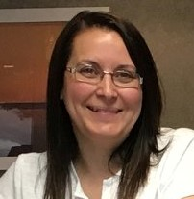
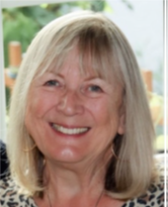
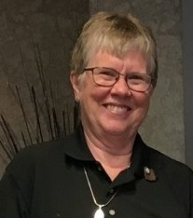
The Implementation Committee Leads
Jacqueline Nogier
Snow Lake, MB
Christa Grillmair
Nanaimo, BC
Sr. Susan Scott
Stony Plain, AB
Notes:
Shari:
Presently the three members of the implementation committee are:
Jacqueline Nogier of Snow Lake, MB
Christa Grillmair of Nanaimo, BC
And Sr. Susan Scott of Stony Plain, AB.
Each year at convention, we have updated you on the progress of working groups and have highlighted something the committee leads wanted to inform you about.
Our leads will now present to you a focus that they have chosen from work done over this past year.
Jacqueline, Christa and Sr. Susan.

Slide 8
Goal 1
Members of The Catholic Women’s League of Canada grow in faith by sharing, witnessing, and developing leadership skills to create positive change.
Notes:
Christa:
Thank you, Shari.
Hello. I am so pleased to share with you the resources that the members of the Goal 1 working groups have created and what is planned.
But before we do that, I’d like to review what our overall goal is:
“Members of The Catholic Women’s League of Canada grow in faith by sharing, witnessing, and developing leadership skills to create positive change.”

Slide 9
How Can We Create Positive Change?
We Train
We Communicate
We Lead
We Inspire
Notes:
Christa:
So, how do we create positive change? (click)
We train (click)
We Communicate (click)
We Lead (click)
We Inspire

Slide 10
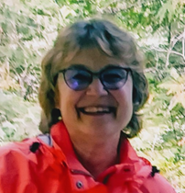
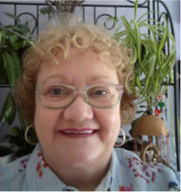
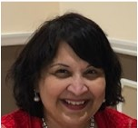
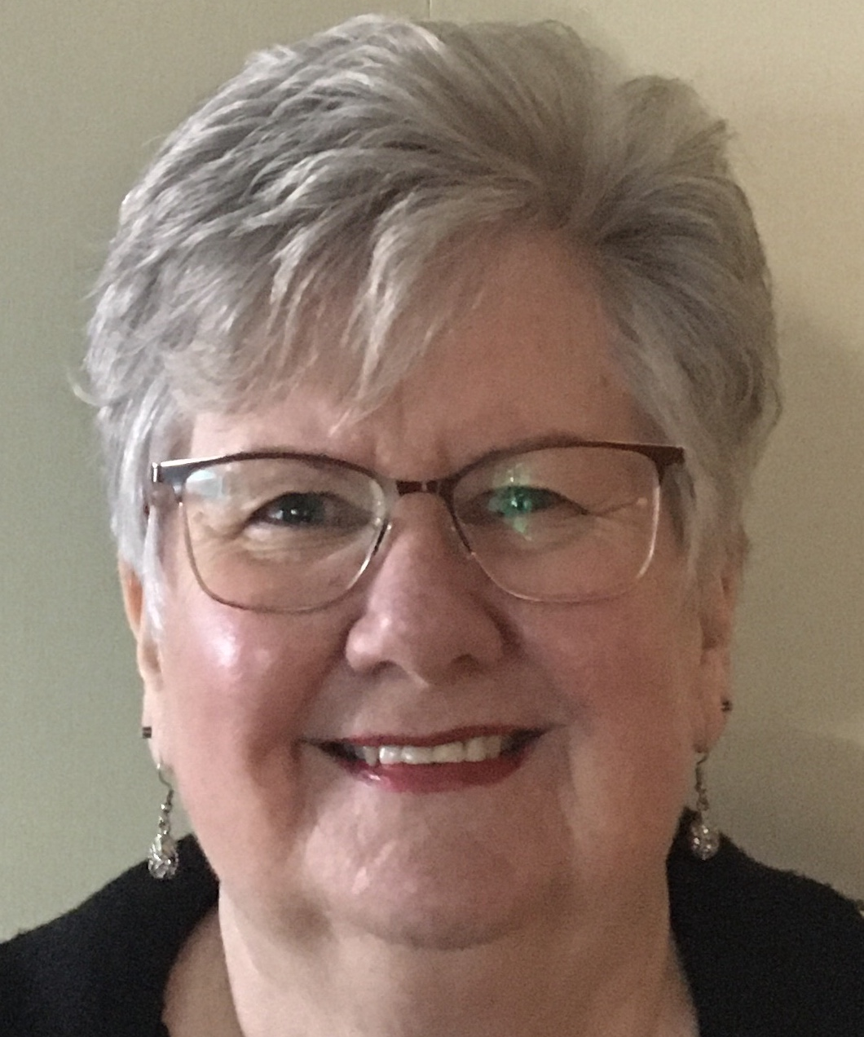
We Train
Mary Capobianco
Etobicoke, ON
Gail Kopp
Limby, BC
Julie LeLievre
Coxheath, NS
Lynette Mendes
Mississauga, ON
Anna Tremblay
North Bay, ON
Notes:
Christa:
When the training and development using technology working group conducted its research, they found that over 63% of those 761 members who responded to the survey have never delivered training of any kind.

Slide 11
We Train
Notes:
Christa:
So, they developed the Train the Trainer Guide where you will learn about different presentation techniques, various delivery skills and the best way to effectively present any course material in order to engage members.

Slide 12
We Communicate
Notes:
Christa:
And we communicate.
We can create positive change by communicating because it creates a relationship and emotional engagement.
This Photo by Unknown Author is licensed under CC BY-ND

Slide 13
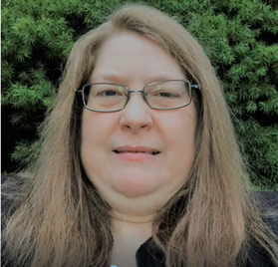
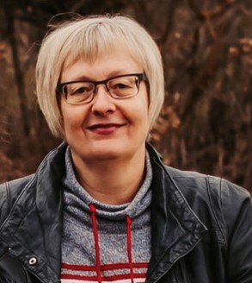
We Communicate
Marilyn Blew
Grande Prairie, AB
Lisa Fillingham
St. Catharines, ON
Anita Kreutzwiser
Wingham, ON
Sr. Susan Scott
Stony Plain, AB
Maria Tejero
Prince George, BC
Notes:
Christa:
Marilyn, Lisa, Anita, Sr. Susan and Maria have developed a Member’s Communication Guide to help increase the effectiveness of our communication. This Guide was created after surveying 1364 members and has been reviewed by 22 members in seven focus groups. The final product is almost ready for launching.
In addition, the group was tasked with improving, streamlining, and expediting internal and external communications. They developed a Communication Process Improvement Recommendations document which was reviewed by 14 executive members in three focus groups. These recommendations will be sent to national for consideration.

Slide 14
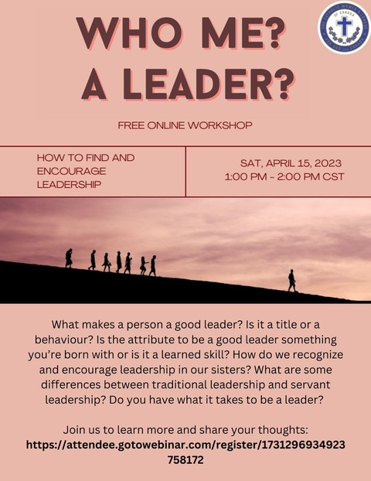
We Lead
Notes:
Christa:
In the “Who Me? A Leader?” webinar, we shared leadership qualities and discussed the misconceptions and fears of leadership. Based on The Joy of Leadership resource, the training and development using technology working group created a five-part workshop that will help to encourage members to take on leadership roles.
These are just a few of the resources that have been created – there are many other workshops on the national website that will help you lead.

Slide 15
We Lead
Notes:
Christa:
Leadership in the League is all about helping others move in a unified direction that builds upon their strengths and capabilities to bring about a better world. Creating positive change can be accomplished if we respond to our baptismal call to discipleship. Christ sent us forth as leaders and we respond by being one!
This is photo of leaders was taken by Bil Gowens at our 2022 national convention.

Slide 16
We Inspire
Notes:
Christa:
Now that we have established the importance of training, communication and leadership and highlighted some of the resources that have been developed to help you, let’s talk about how we can inspire others.
(Image Source: PowerPoint Stock image)

Slide 17
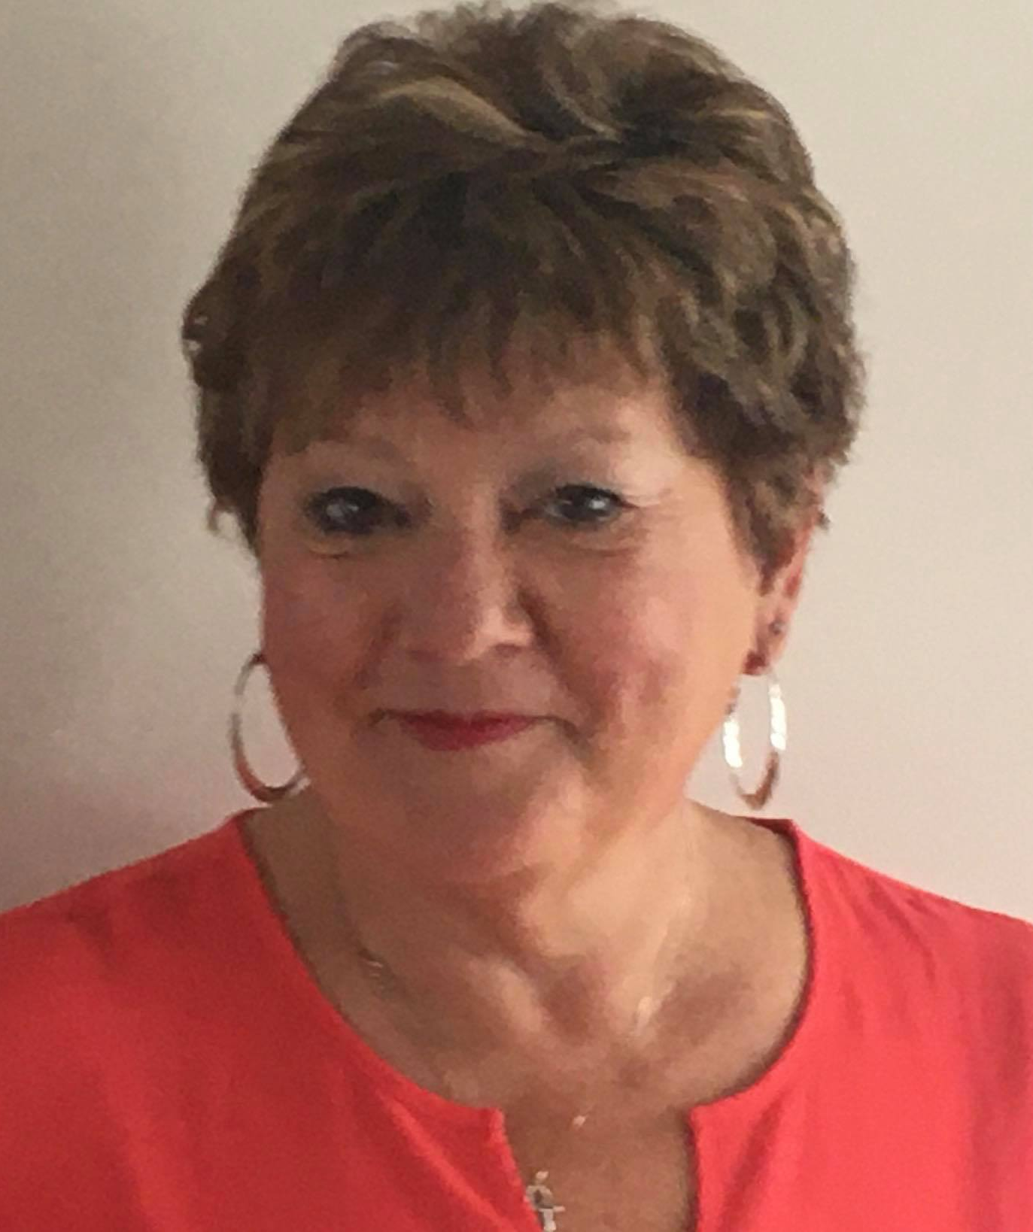
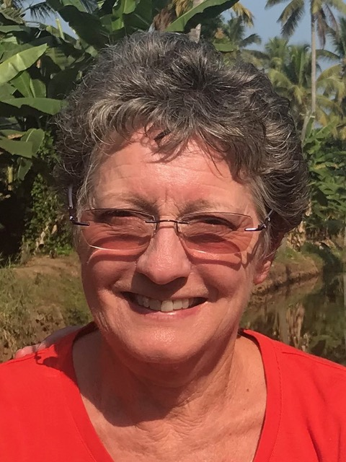
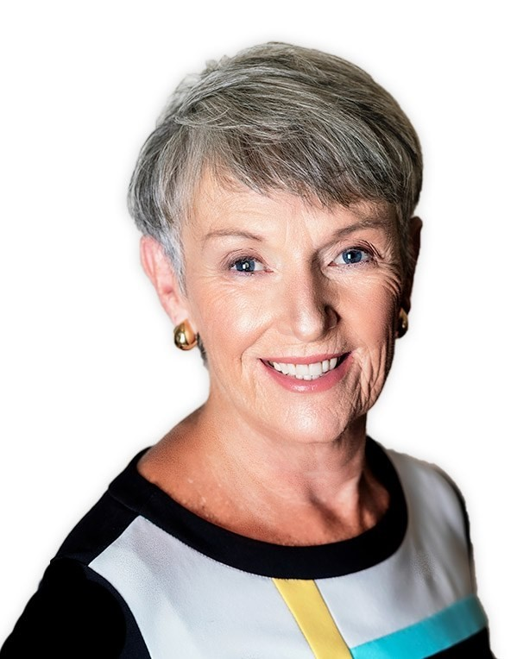
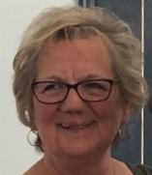
We Inspire
Connie Crichton
Saskatoon, SK
Kathy Dahl
Kamloops, BC
Lisa Fillingham
St. Catharines, ON
Jessie Parkinson
New Glasgow, NS
Sr. Susan Scott
Stony Plain, AB
Terry Mae Sinclair
Salmon Arm, BC
Notes:
Christa:
The Marketing working group worked with Clark Marketing Communications to develop the many resources that are available for you on the Inspire and Resources sections of the national website.

Slide 18
We Inspire
Powerful Stories
#WhatsYourCWL
Why Be A Member
National Sisterhood
Share the Words
Notes:
Christa:
We developed stories that celebrated our first 100 years. (click)
Members were inspired to use social media to share why they are members. (click)
We developed vignettes that talked about the many ways we effect change. (click)
We showcased our national sisterhood. (click)
Since the CWL means many things to people, we created 52 talking points to start the conversation.

Slide 19
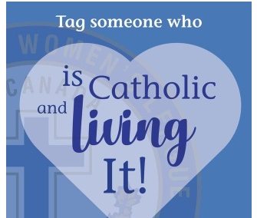
Notes:
Christa:
All the resources have been created for you. I encourage you to use them to inspire others. Show the vignettes at meetings or at special parish presentations. The words are great conversation starters. Put one in each week’s parish bulletins or monthly newsletter.

Slide 20
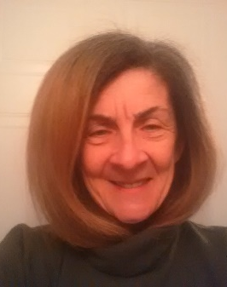
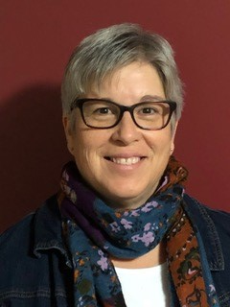
WHAT’S PLANNED
Marie-Claire Arseneau
Halifax, NS
Belinda Halbach
Legal, AB
Diane Lemay
Longueuil, QC
Notes:
Christa:
So, what’s planned? Marie-Claire, Belinda and Diane have started to develop a protocol to evaluate spiritual programs.

Slide 21
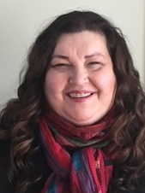
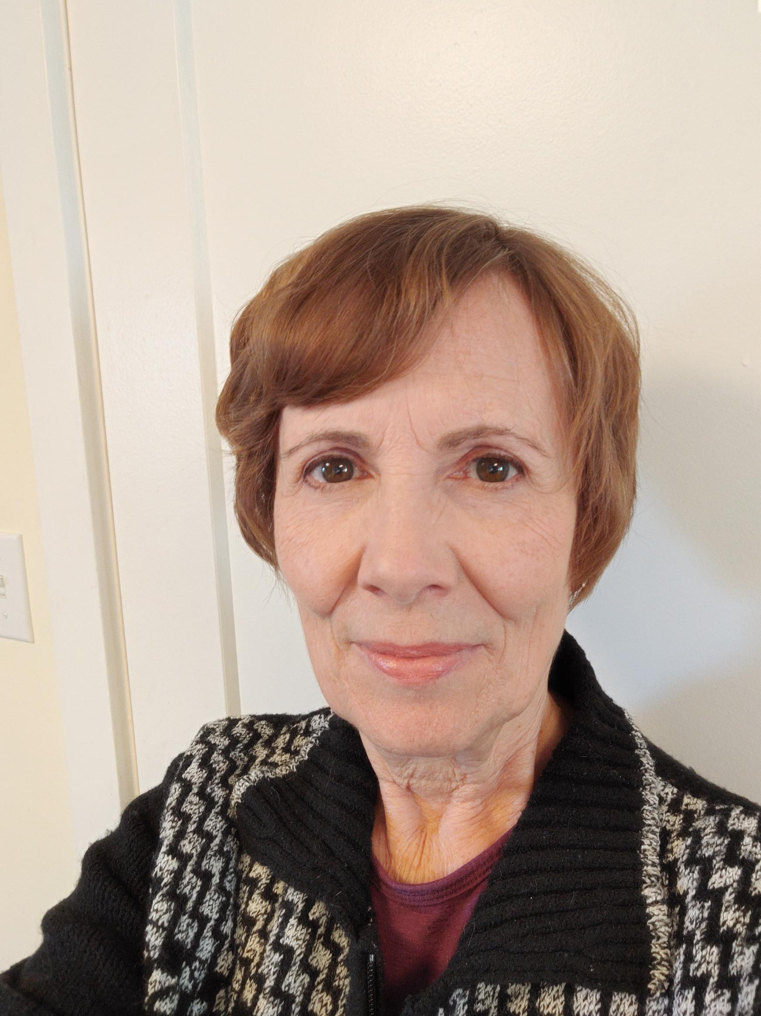
WHAT’S PLANNED
Denise Forgeron
Sydney, NS
Linda Maddaford
Yorkton, SK
Liz McInnis
Kapuskasing, ON
Joan Schurter
Kitchener, ON
Notes:
Christa:
And Denise, Linda, Liz and Joan of the recruit parish leaders working group have formed to develop a guide to help recruit parish leaders.

Slide 22
How Can We Create Positive Change?
We Believe We Can
We Work Together
We Use Available Resources
Notes:
Christa:
So, how can we create positive change? (click)
We believe we can! (click)
We have our faith to guide us and the support of more than 60,000 sisters to walk with us. (click)
If we use the many resources that are at our fingertips to train, communicate, lead, and inspire, we will create the positive changes that will position us for the next 100 years.

Slide 23
How Can We Create Positive Change?
Notes:
Christa:
And… Use your Superpower!

Slide 24
End with 30 second Commercial Video
Notes:
Thank you!

Slide 25
Goal 2
The Catholic Women’s League of Canada addresses and supports Catholic social teaching through advocacy.
Notes:
Sr. Susan:
Thank you Christa.

Slide 26
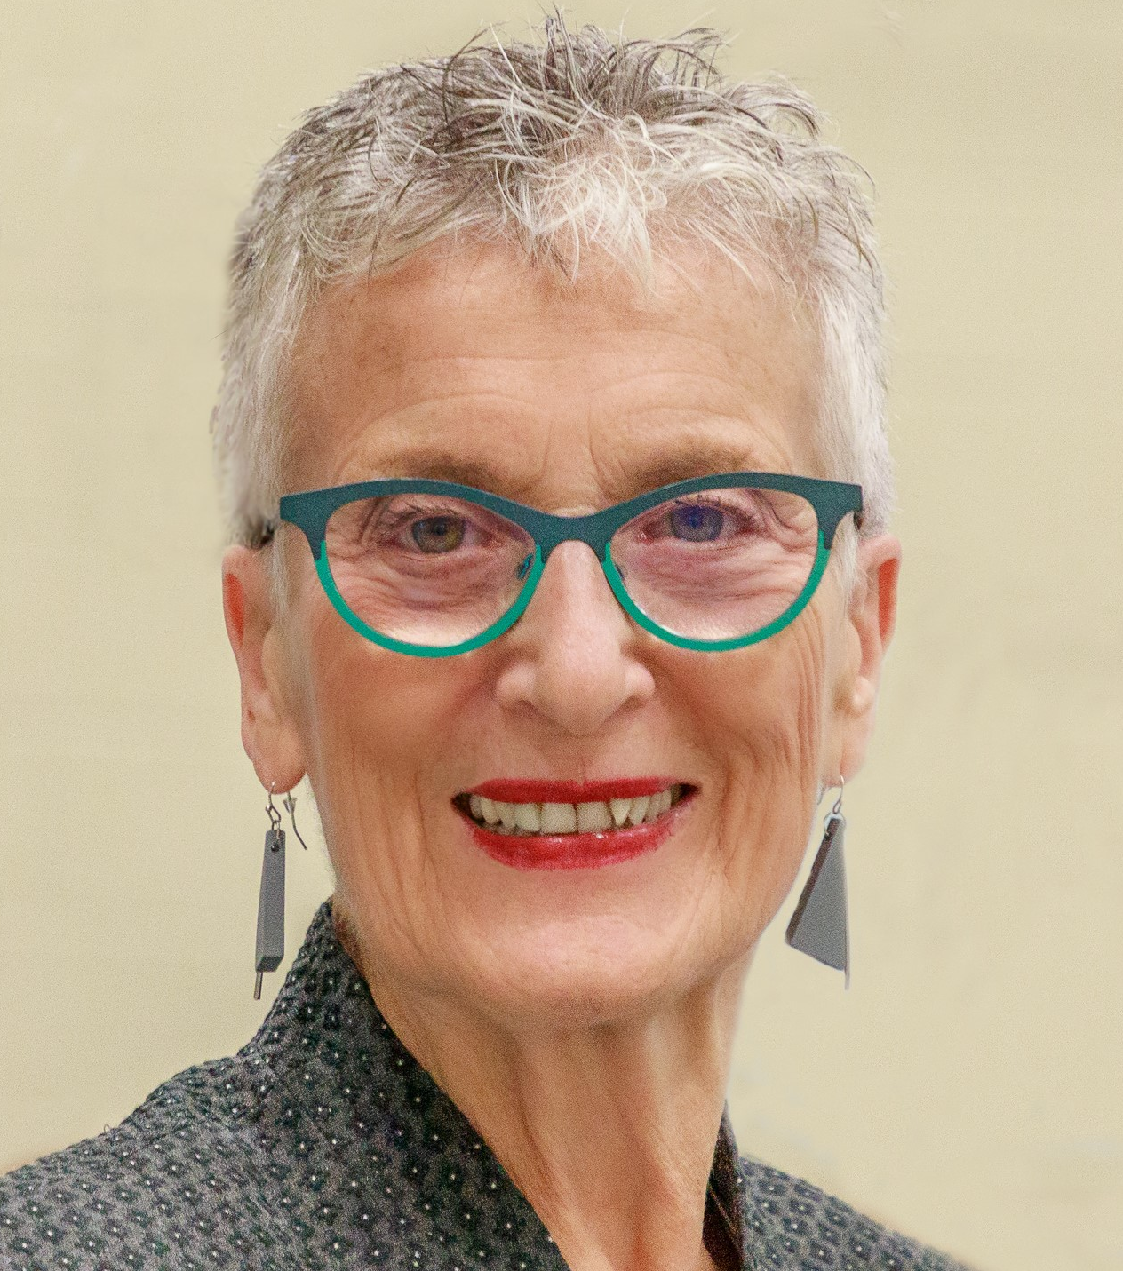
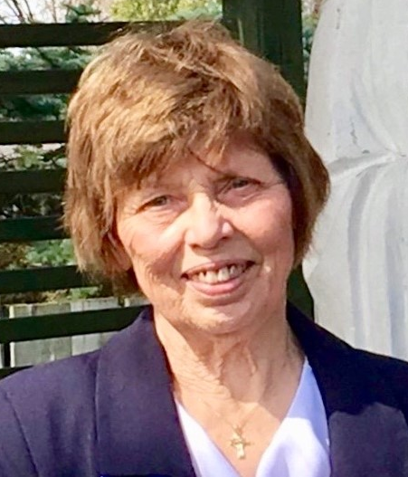
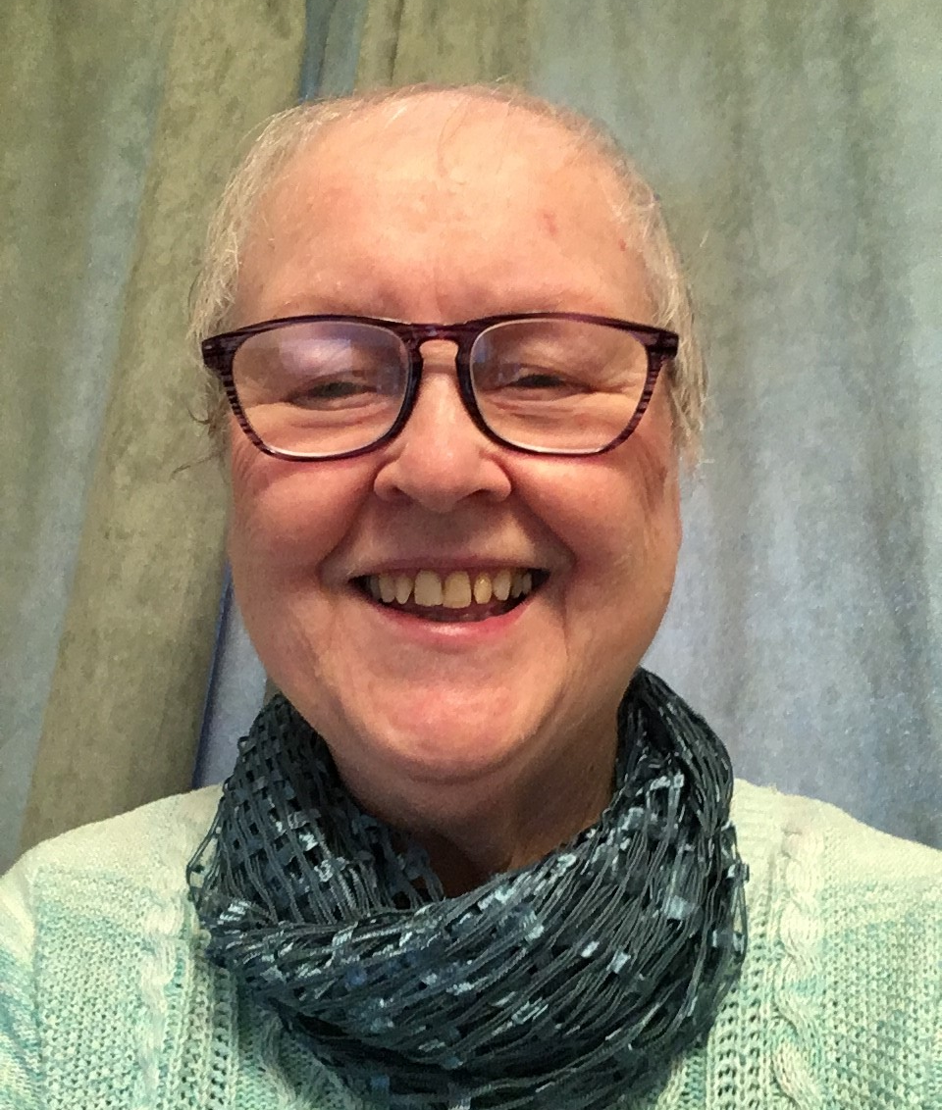
Advocacy Working Group
Margot de la Gorgendiere
Edmonton, AB
Sylvia Jurys
West Kelowna, BC
Glenda Klein
Lindsay, ON
Diane Lemay
Longueuil, QC
Notes:
Sr. Susan:
The women of the advocacy working group, Margot, Sylvia, Glenda and Diane are thrilled to have their long-awaited workshops available on the national website for anyone to download. With the new executive structures now being implemented across the League, there is a concern being voiced that we have lost our focus on resolutions that have made us such a distinctive, faith-based and action-oriented organization.
By the end of my presentation, I hope to not only dispel this concern, but help members recognize that with the implementation of the strategic plan and the strategies of Goal 2, this work has been highlighted with new resources available to encourage our members in their advocacy and government collaboration work.

Slide 27
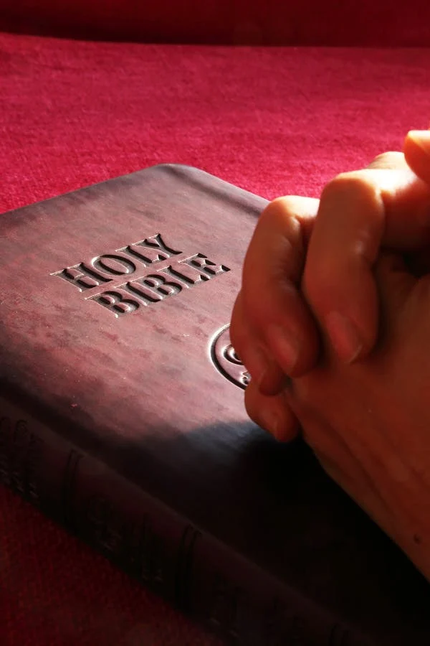
Advocacy is Rooted in Scripture
“The spirit of the Lord God is upon me, because the Lord has anointed me;
he has sent me to bring good news to the oppressed,
to bind up the broken-hearted,
to proclaim liberty to the captives,
and release to the prisoners;
to proclaim the year of the Lord’s favour...”
(Isa 61:1-2)
Image source: pexels.com/photo/belief-bible-book-business-267559/
Notes:
Sr. Susan:
The challenge of both the Old and New Testament is to reach out to the poor and to practice justice. This is a non-negotiable mandate given to every Christian, just as non-negotiable as is the mandate to keep the commandments.
The great Jewish prophets coined this mantra: “The quality of your faith will be judged by the quality of justice in the land; and the quality of justice in the land will always be judged by how “widows, orphans, and strangers” are doing. (Matthew 25).
In the words of Fr. Ron Rolheiser, “Jesus not only ratifies this; he deepens it further by stating that his very presence and person are in the poor. “Whatsoever you do to the least, you do to me!” (Matthew 25).
For those of you who like numbers, consider these - In the New Testament:
One in every ten lines is a challenge to us to reach out to the poor.
In the Gospel of Luke, this challenge is in every 6th line.
In the Letter of James, this challenge is in every 5th line.”
(Source: Ron Rolheiser OMI Star of the North Retreat, December 2022)

Slide 28
Key Principles of Catholic Social Teaching
Life and Dignity of the Human Person
The Call to Family, Community, and Participation
Rights and Responsibilities
Options for the Poor and Vulnerable
Dignity of Work and the Rights of Workers
Solidarity – Community and the Common Good
Care for God’s Creation
Notes:
Sr. Susan:
We advocate using the key principles of Catholic social teaching which are: (click)
Life and Dignity of the Human Person (click)
The Call to Family, Community, and Participation (click)
Rights and Responsibilities (click)
Options for the Poor and Vulnerable (click)
Dignity of Work and the Rights of Workers (click)
Solidarity – Community and the Common Good and (click)
Care for God’s Creation

Slide 29
Why Do We Advocate? We Have Been Baptized into Christ
Image source: freeimages.com/photo/baptismal-font-5-1178903
Notes:
Sr. Susan:
Social justice is foundational to our baptism—it is one of the pillars of the church and our faith. In the words of the Catechism of the Catholic Church, “Holy Baptism is the basis of the whole Christian life, the gateway to life in the Spirit… and the door which gives access to the other sacraments. ...We become members of Christ, are incorporated into the Church and made sharers in her mission” (1213).
In her book titled “Walking Together: A Primer on the New Synodality”, Moira McQueen states that “It is this baptism that Pope Francis has explained that allows us to walk together, “as befits [our] common baptism as members of the People of God in shaping the future Church… Walking together is a way for lay people to further their baptismal mission through joining the ordained in the discernment gifted by the Spirit to all the baptized”.

Slide 30
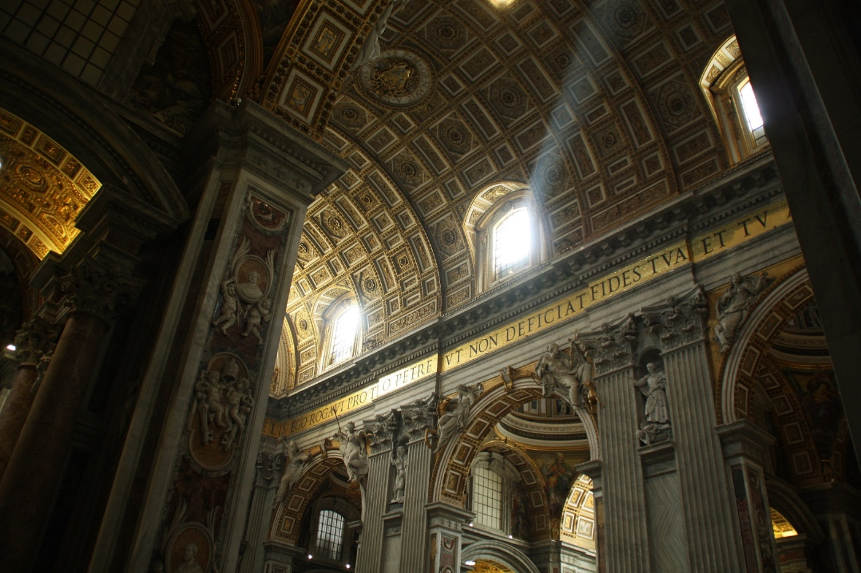
Why Do We Advocate? Vatican II: Reading the Signs of the Times
Notes:
Sr. Susan:
Moira McQueen states that “A major thrust of the Second Vatican Council is that the whole People of God is now the emphasis: a communion, a joint membership of every individual by virtue of the sacrament of baptism.
This vision of walking together – synodality – “reflects the spirit and intent of the Second Vatican Council… which… emphasized our common baptism as the essential qualification for membership in the Body of Christ, in which each one of us has a specific vocation and purpose. This radical equality conferred by baptism needs to be recalled and revitalized in every aspect of Church life until it is more adequately realized by all, especially among the laity” (ibid).
One of the shining, prophetic calls of this Vatican II document Gaudium et Spes – Joy and Hope was to “Read the signs of the times…” In the words of the late Karl Barth, one of the most influential theologians of the 20th century. “Take your Bible and take your newspaper, and read both.”

Slide 31
Why Do We Advocate? …THY KINGDOM COME
“The kingdom of God has come near to you” (Lk 10:9).
Notes:
Sr. Susan:
In his book “Deconstructing Sacramental Theology and Reconstructing Catholic Ritual, Joseph Martos writes “Entering God’s kingdom is a metaphor for doing God’s will, and God’s will as revealed through Jesus is that people should take care of one another”.
Religious rituals versus justice in the land is a theme that runs through the Old Testament (e.g., 1 Samuel 15:22, Isaiah 1:11-17, Jeremiah 6:20, Proverbs 21:3) and into the New Testament. When a religious scribe responds to Jesus that loving God and one’s neighbour “is much more important than all whole burnt-offerings and sacrifices,” Jesus replies, “You are not far from the kingdom of God” (Mk 12:33-34).
Michael N. Okińczyc-Cruz, Executive Director of Coalition for Spiritual and Public Leadership states that “Jesus witnessed in these and countless others, a deep and divine yearning for dignity, respect, and hope. He understood their yearning for water, bread, shelter, land, safety, and justice. It moved him deeply, because liberation from the yoke of oppression is always to be at the center of God’s reign.”

Slide 32
What Exactly is Advocacy?
Notes:
Sr. Susan:
What is advocacy? It is a way of promoting public support for an idea, plan or way of doing something. It may be an initiative, or it may be a change to an existing process or law.
League advocacy reflects our baptismal call to use our voices to speak for the poor and marginalized. It adheres to the seven principles of Catholic social teaching. It includes the education and mobilization of members, so that they can be informed about issues, take action and become involved in developing and promoting solutions for causes about which they care. It calls members to identify and be part of changes that address the symptoms and the underlying causes of injustice.

Slide 33
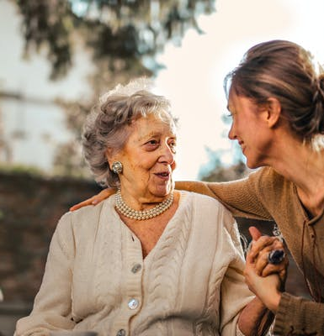
What is Faithful Advocacy?
It is when our actions and efforts seek to create a more socially just, ecologically sustainable and spiritually fulfilling society.
It is part and parcel of living our lives as if the gospel, our faith tradition, our neighbours (especially the poor and oppressed) and the earth really matter!
It is putting flesh onto our call to be faithful disciples of Jesus.
Image source: pexels.com/search/caring/
Notes:
Sr. Susan:
What is faithful advocacy? (click)
It is when our actions and efforts seek to create a more socially just, ecologically sustainable and spiritually fulfilling society. (click)
It is part and parcel of living our lives as if the gospel, our faith tradition, our neighbours (especially the poor and oppressed) and the earth really matter! (click)
It is putting flesh onto our call to be faithful disciples of Jesus.

Slide 34
Advocacy and Collaboration
Advocacy
Government Collaboration
Notes:
Sr. Susan:
We are called to advocate, and this call to action is rooted in our sacred scriptures, baptism and the call from the church through the Second Vatican Council documents and our growing tradition and writings on Catholic social teaching. Advocacy is like the whole pie.
Government collaboration is a subset of advocacy. In other words, any collaboration with any level of government is an example of advocacy. Our work on national resolutions is, by its very nature, advocacy.

Slide 35
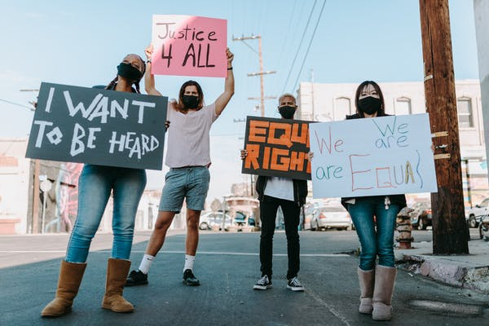
For What Do We Advocate?
Image source: pexels.com/search/protest/
Notes:
Sr. Susan:
Advocating can be as simple as calling your school administrator encouraging them to initiate protocols for healthier snacks being available in the building. It might be encouraging the pastoral council at your parish to eliminate Styrofoam use. It might be advocating with your parish finance committee to make decisions that allow your church to be more energy efficient or to use less water, or to reduce the temperature in the building.
You might advocate with local organizations to plant more indigenous wildflowers and tree species.
As you think about how YOU would answer this question, consider the eight corporal works of mercy that are foundational to our faith:
feed the hungry,
give drink to the thirsty,
clothe the naked,
give shelter to homeless and refugees,
visit the sick and imprisoned, and to bury the dead.
You will notice that I have only read seven. That is because Pope Francis has added one more to this time-honoured list – care for creation.

Slide 36
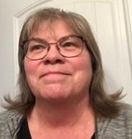
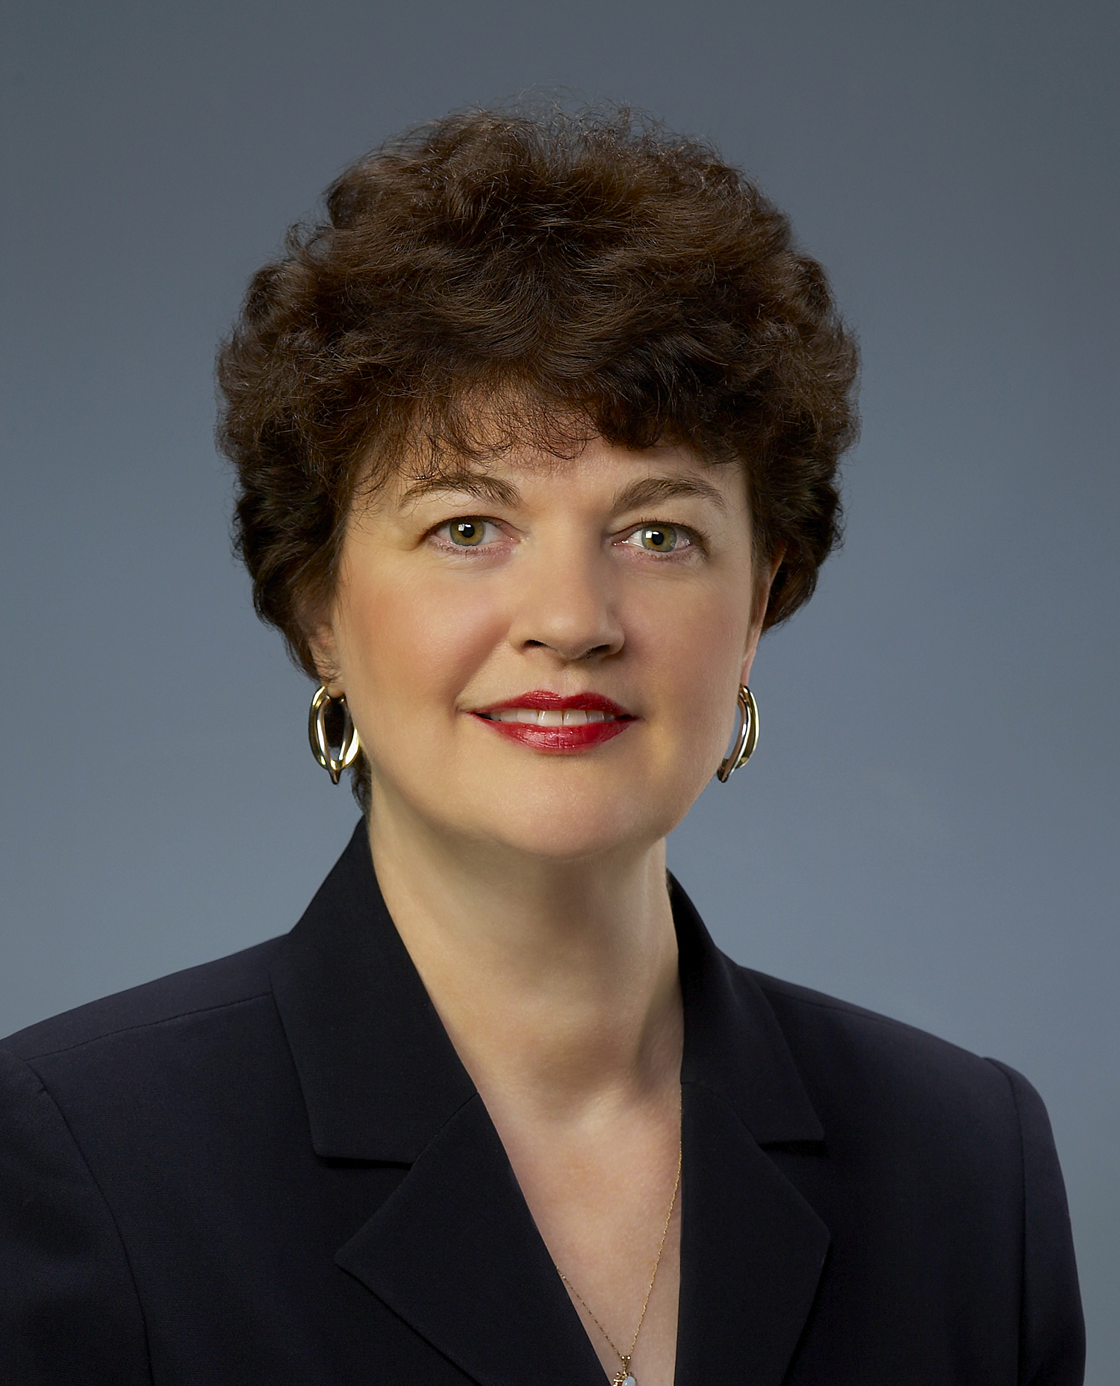
Collaboration With Government Working Group
Ruth Boden
Evansburg, AB
Diane Cote
Saskatoon, SK
Janice Graham-Migel
Halifax, NS
Claudette Langdon
Stittsville, ON
Notes:
Sr. Susan:
The three workshops developed by the collaboration with government working group consisting of Ruth, Diane, Janice and Claudette are now available. All these workshops were developed with parish councils in mind. Ease of presentation, flexibility, participant interaction and being able to use the resources without having to “bring in an expert”, were priorities in developing these resources.
Know that with these tools, our members will continue to advocate for those most in need and collaborate with governments at any level. This is our history; this is our mandate as League members and baptized disciples of Christ.

Slide 37
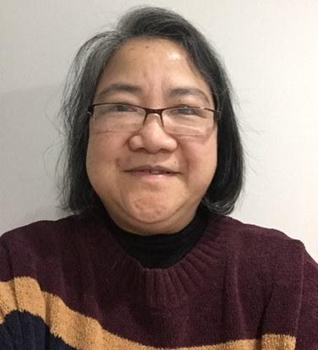
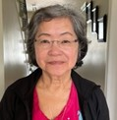
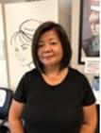
Collaboration With Faith Organizations Working Group
Lolita Doucette
Vancouver, BC
Marissa Mendoza
Mississauga, ON
Theresa Murphy
Fort Erie, ON
Lawina Notario
Mississauga, ON
Notes:
Sr. Susan:
The final strategy for Goal 2 of the strategic plan is the faith organizations working group consisting of Lolita, Marissa, Theresa and Lawina. They have produced a wonderful video to highlight the importance of developing both ecumenical and interfaith connections in our communities. There is excellent educational content around both of these areas and some personal examples of how some parish councils are already committed to this priority.

Slide 38
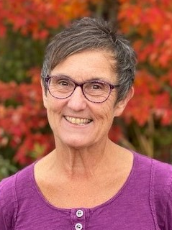
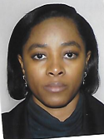
Software to Facilitate Collaboration
Cheryl Boom
Kinkora, PE
Felicia Onateh
Montreal, QC
Notes:
Sr. Susan:
The final strategy for Goal 4 is the software to facilitate collaboration working group of Cheryl and Felicia. Their task is to identify at all levels of the League, the needs, both present and future, that will help determine software that may be used to allow collaboration and ease the burden within councils. Their final deliverable will be a collaboration software guide.

Slide 39
Goal 3
Through outreach and service, members of The Catholic Women’s League of Canada foster a culture where all life is valued with dignity and respect.
Notes:
Jacqueline:
Thank you Sr. Susan.

Slide 40
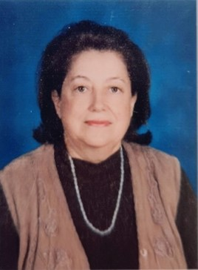
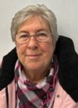
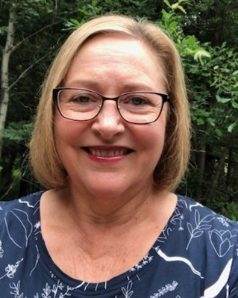
Year 4: Mentor Members Working Group
Diane Lauziere
Toronto, ON
Karen McKeown
Etobioke, ON
Linda VandenBerg
High Prairie, AB
Notes:
Jacqueline:
The Mentor Members working group was made up of Diane, Karen and Linda.
This group was responsible for completing two strategies:
Capitalize on the expertise of others, including engaging life members as mentors
Focus on intergenerational skills mentorship

Slide 41
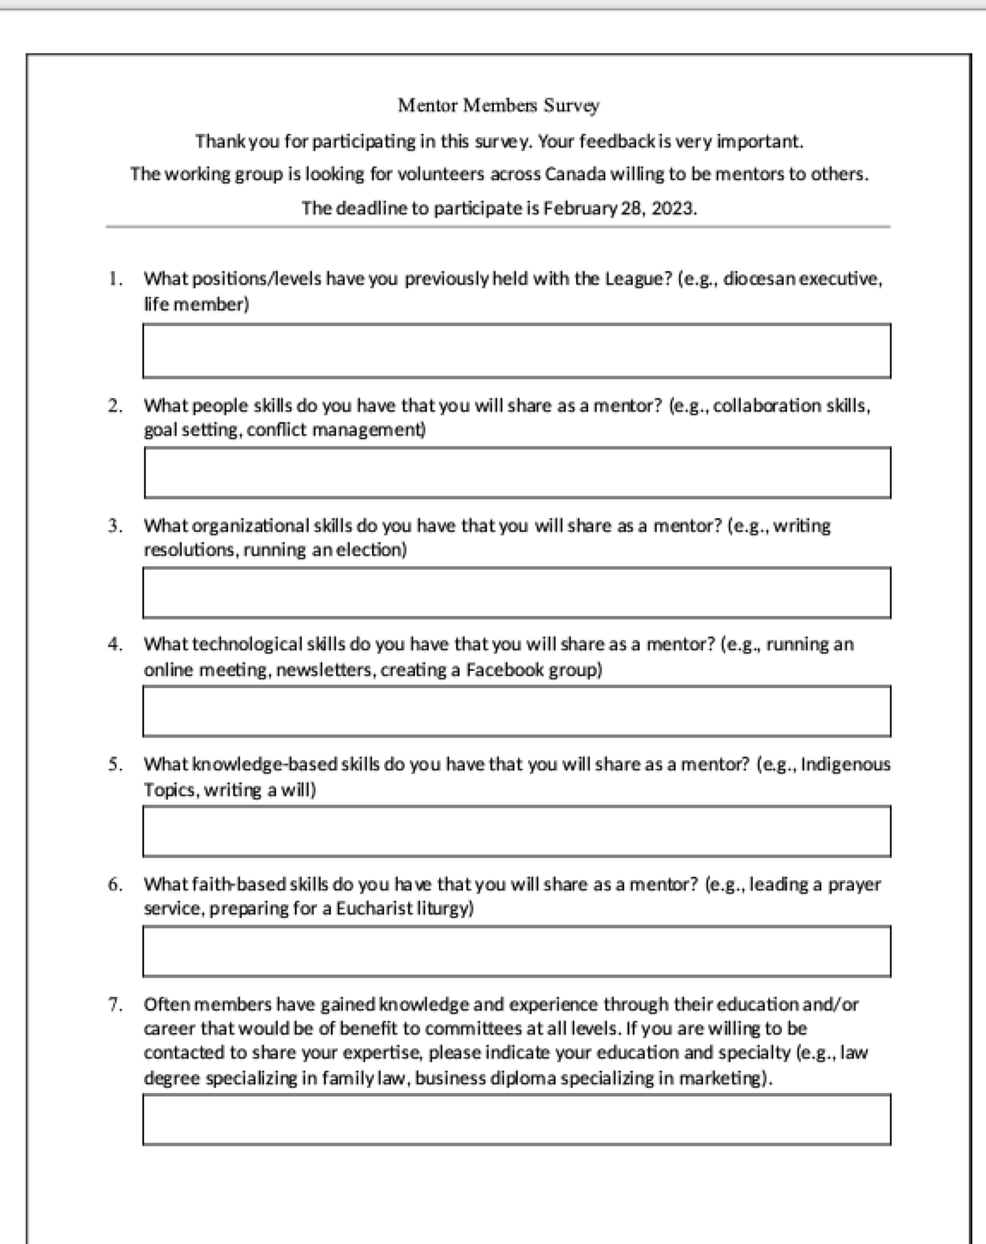
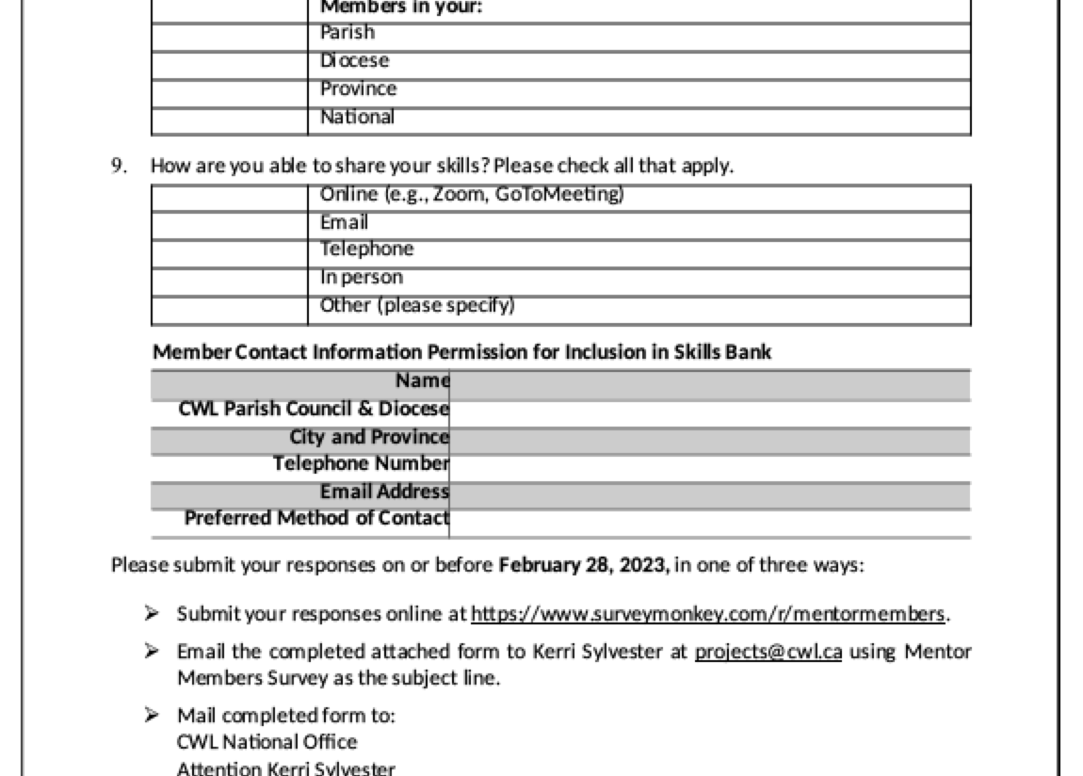
Create and Circulate Survey
Notes:
Jacqueline:
The working group created and compiled the results of a survey that was open to all members, including life members, and those members on national, provincial, regional, and diocesan executives. (click)
They reached out to parish councils through provincial presidents and asked for parish council members to share their expertise. (click)
130 women from across Canada answered the call.
41 of those members indicated that they were Life Members
51 indicated they have served on Provincial Council,
15 indicated they have served on National Council, and
9 indicated they have served on national sub-committees
Raise your hand if you remember receiving a copy of this survey. Leave your hand up if you completed the survey! Thank you!

Slide 42
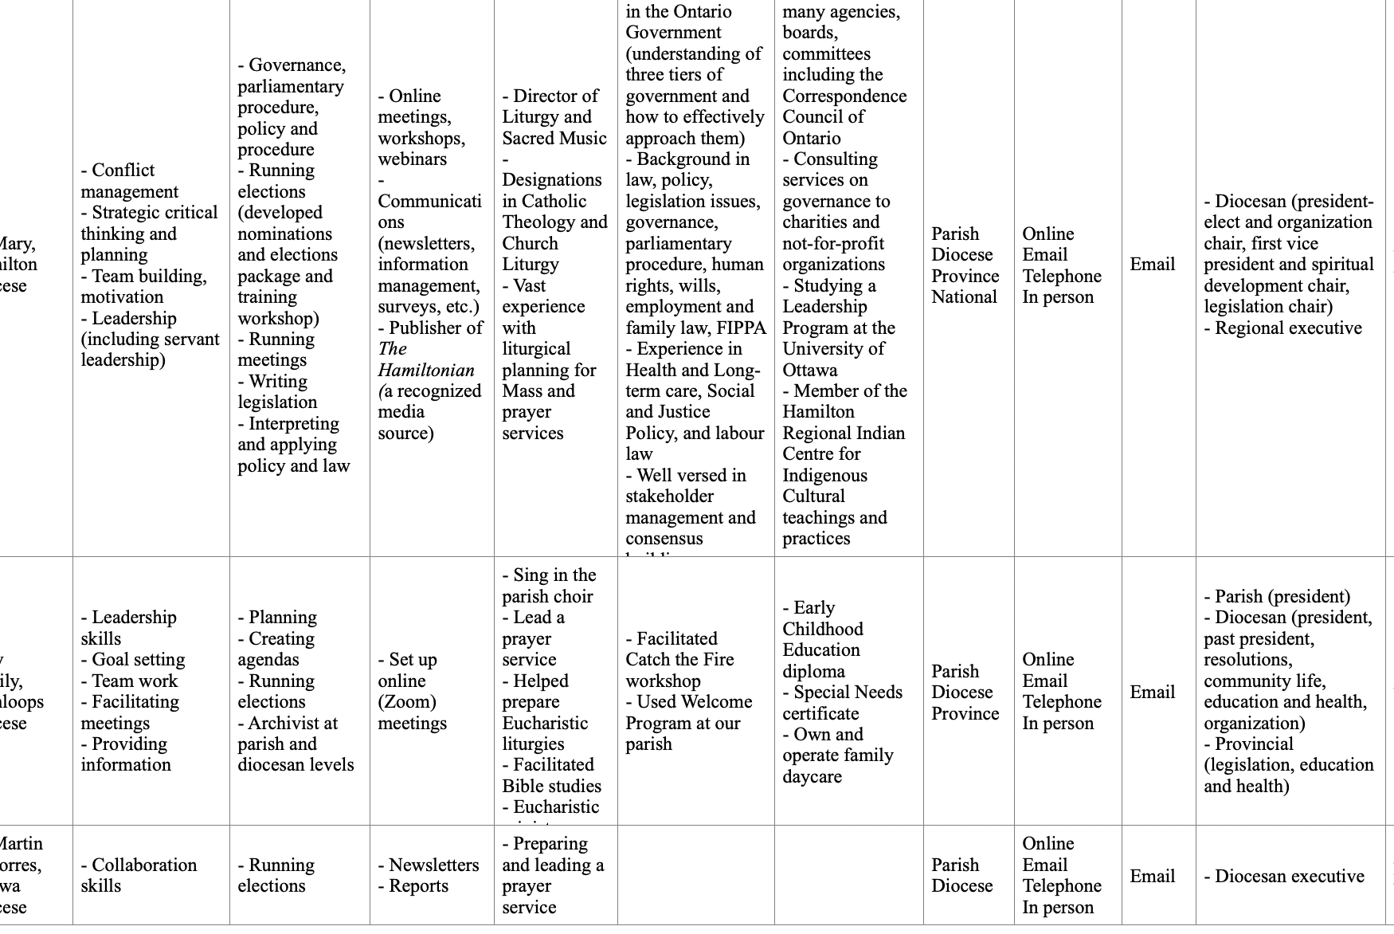
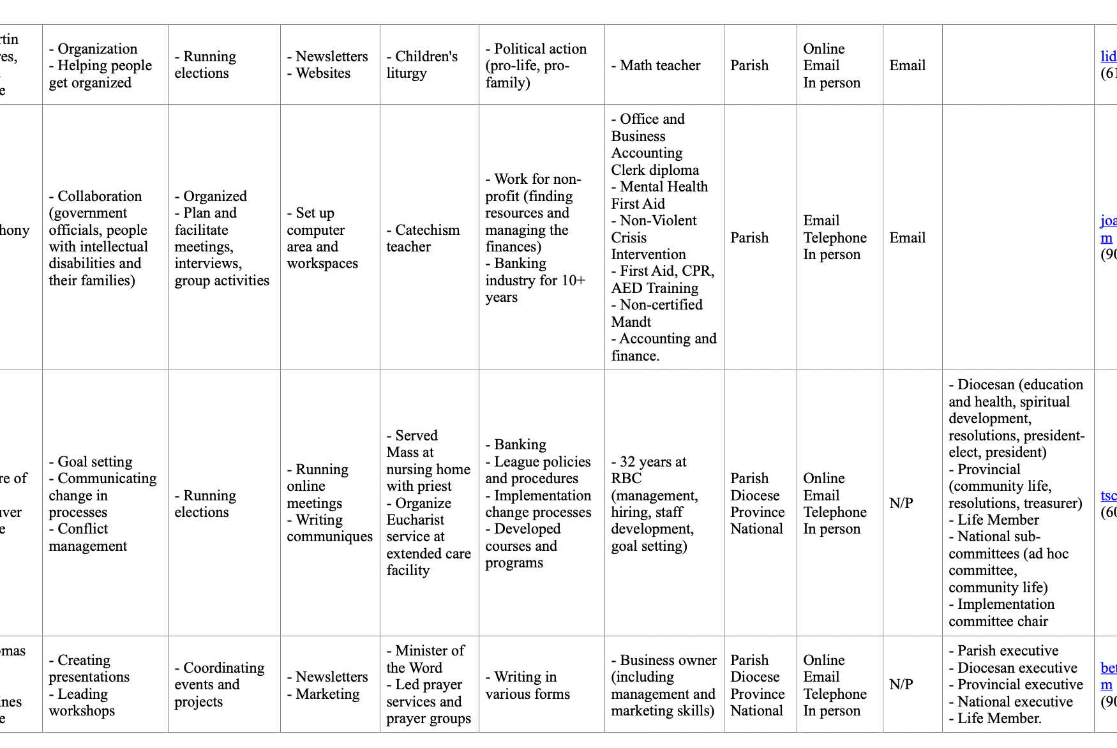
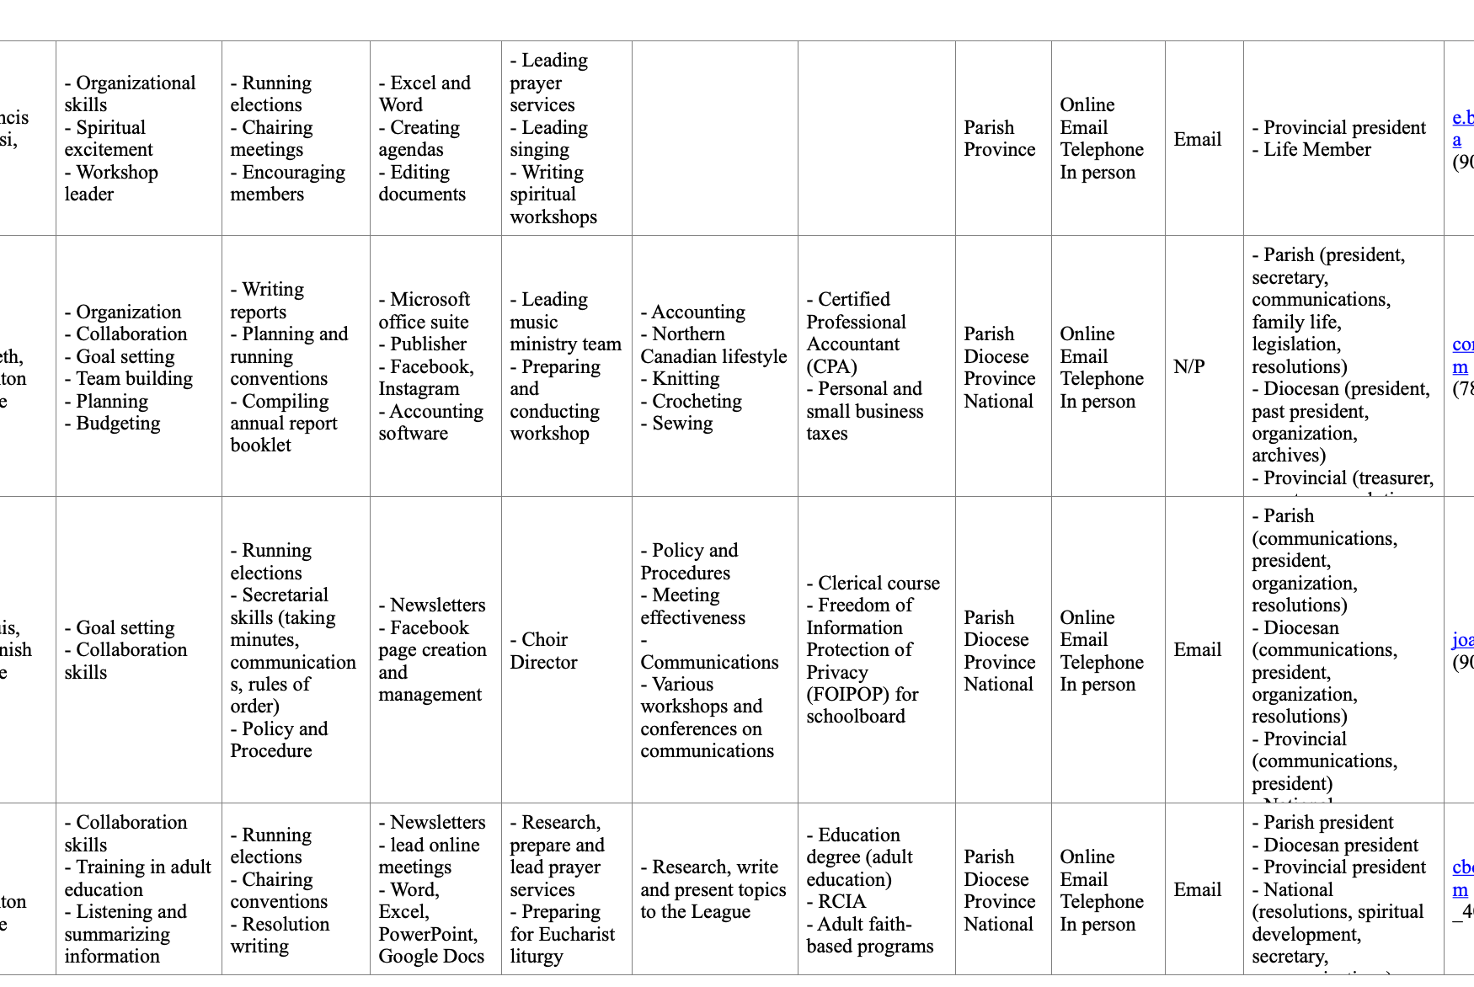
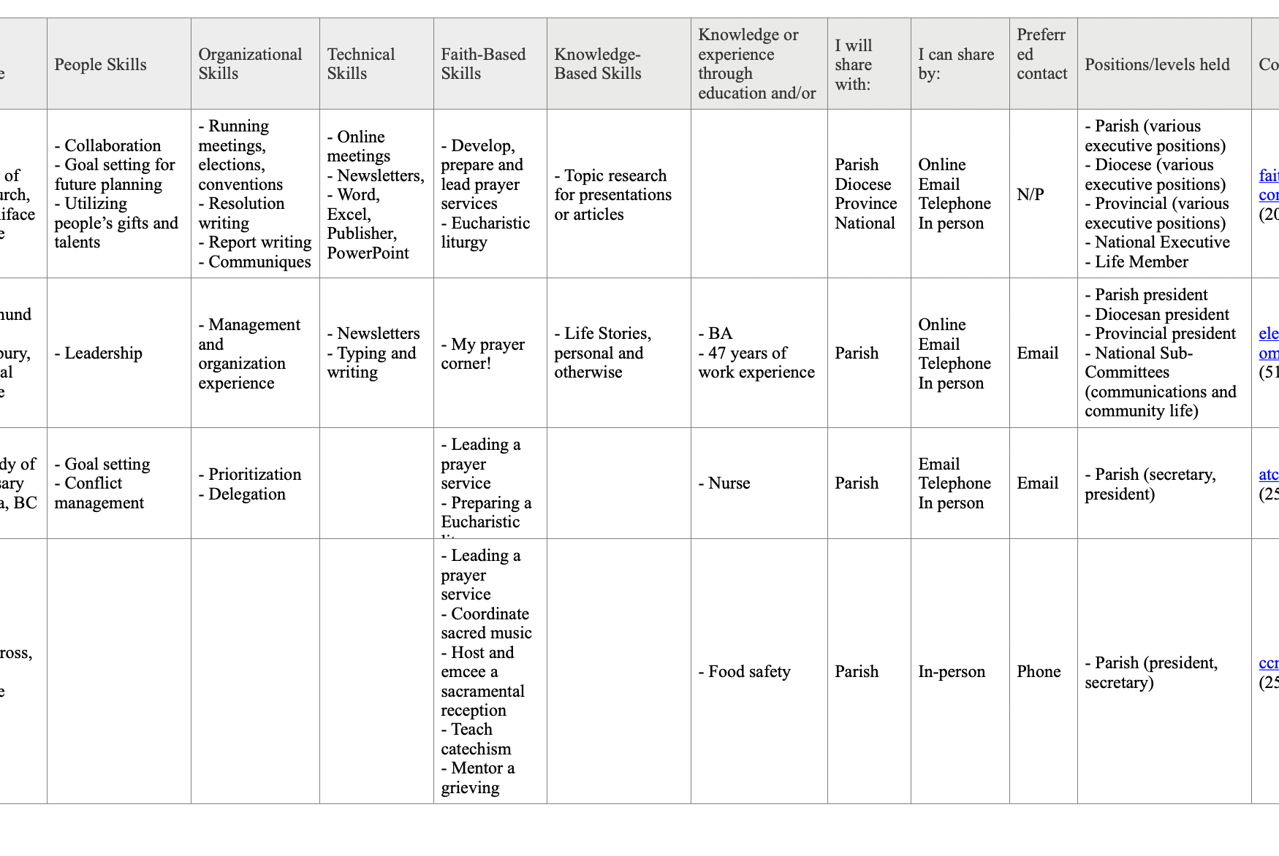
Skills Bank
Notes:
Jacqueline:
A skills bank was created. (click)
This will allow councils to draw on the expertise of our sisters in our dioceses, province, and even across the country. (click)
So how will you use this skills bank? (click)
Even though we only have a draft version of the document I have a couple of examples to help you figure it out!

Slide 43
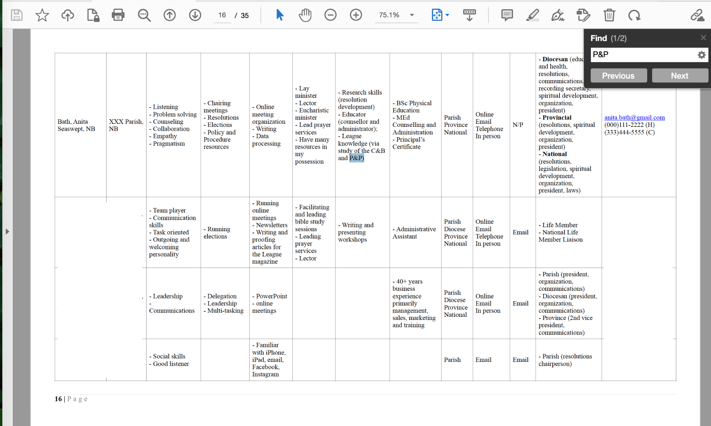
Notes:
Jacqueline:
To do a search in the document use “control F” (or command F if you use a Mac) to bring up the search bar. Maybe you need help creating or editing a policy and procedure manual? You can use the skills bank to search for someone to help with that! (click)
If you type “P&P” into the search bar you can see “1 of 2” beside the word “find”. This means that there are 2 people that have knowledge to share about P&P’s.
(click) The first woman, Anita Bath lives in Seaswept, NB. She has indicated that she has “League knowledge via study of the C&B and P&P”
(click) She also indicates that she understands “Policy and Procedures resources”.
(click) You can reach her by email, or by calling her home phone or cell. She is willing to share her knowledge with you online, or by email, telephone or in person.
https://humorliving.com/name-puns/

Slide 44
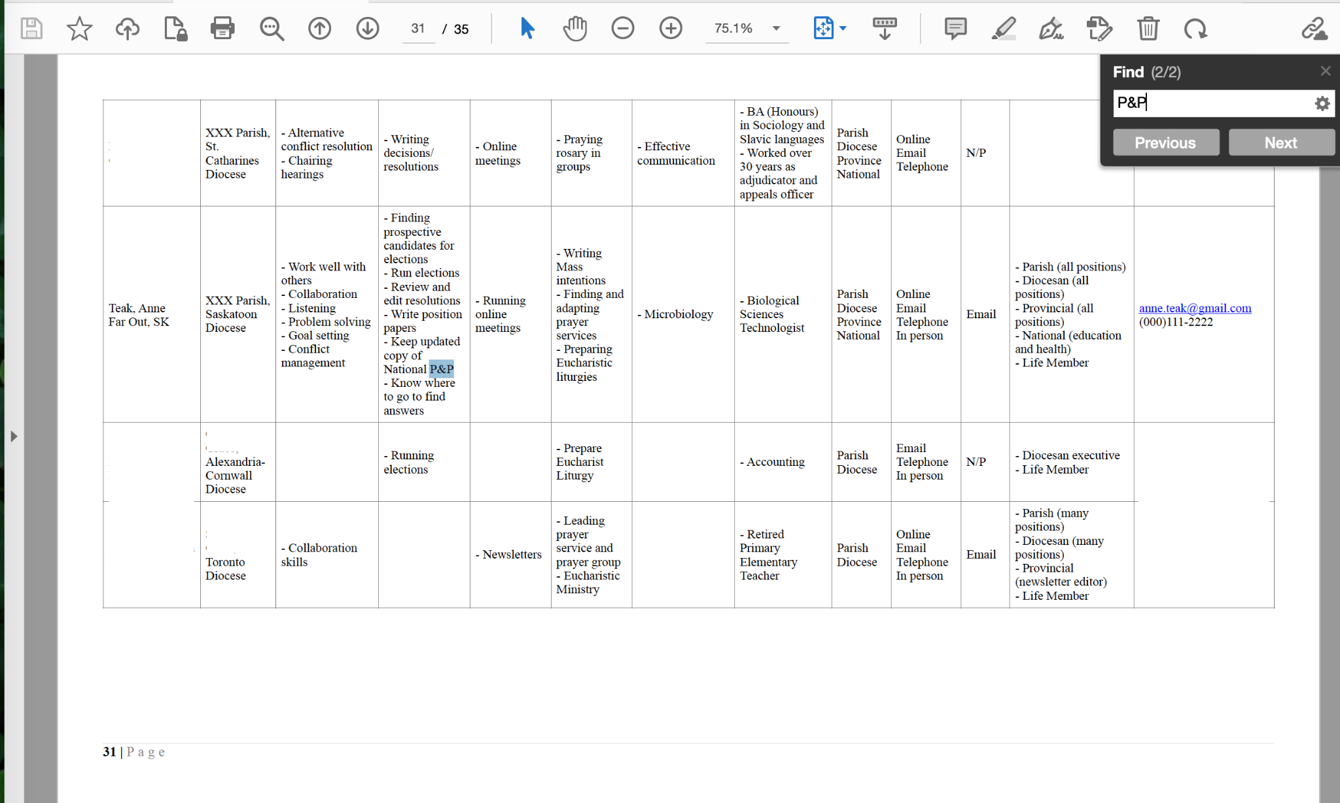
Notes:
Jacqueline:
The second woman, Anne Teak, is from Far Out SK. She indicates that she keeps an updated copy of the National P&P. If you are looking for someone to help you write a policy and procedure manual, maybe Anne Teak or Anita Bath are not the people to help you.

Slide 45
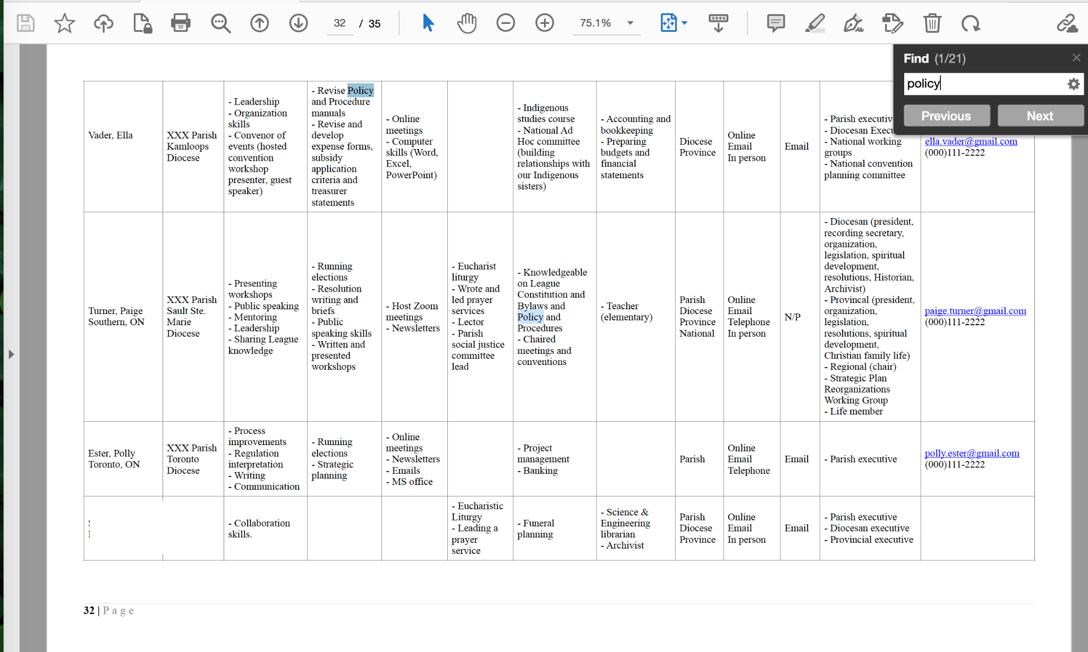
Notes:
Jacqueline:
When you change your search from “P&P” to “policy” (click) you can see that instead of 2 results you find 21.
(click) Ella Vader says she can help members revise policy and procedure manuals
(click) and Paige Turner has knowledge on Policy and Procedures. If you keep clicking “next” you will scroll through the document finding all of the places that the word “policy” appears.

Slide 46
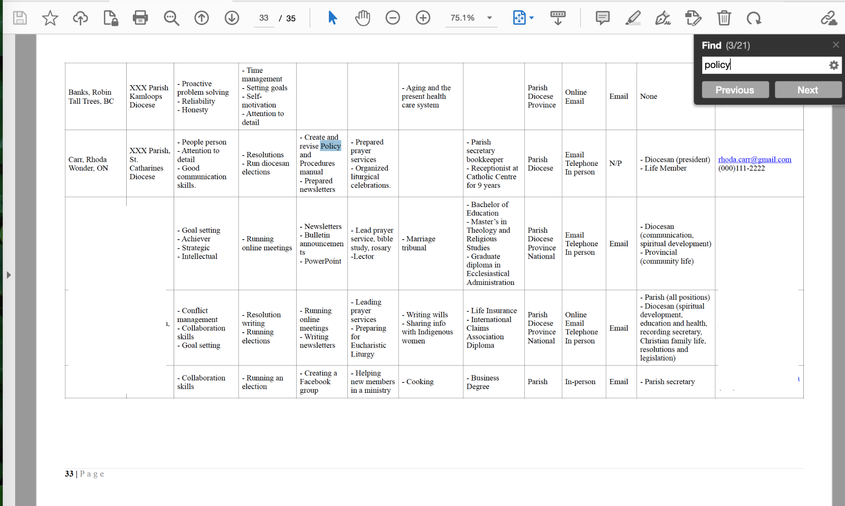
Notes:
Jacqueline:
Rhoda Carr will help you “Create and revise Policy and Procedures manuals”. She prefers to share her knowledge by email, phone, or in person. If you live close to Wonder, ON and want to meet in person - Rhoda might be the help you need.

Slide 47
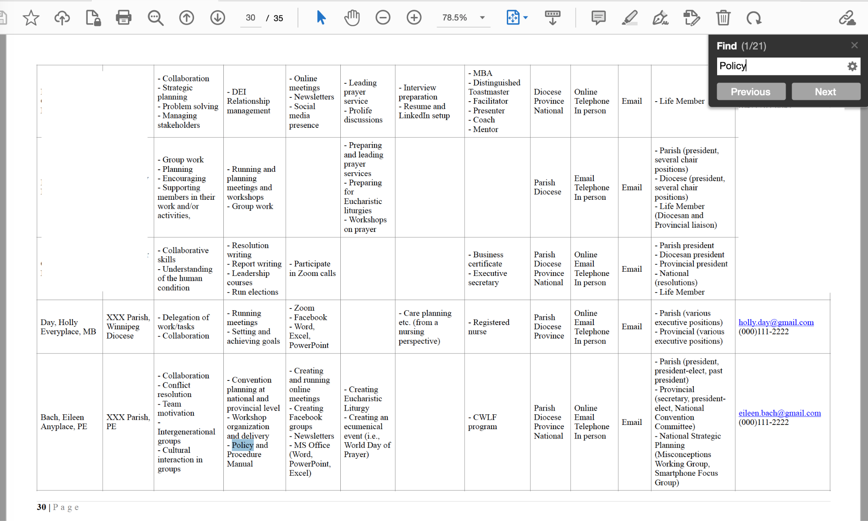
Notes:
Jacqueline:
There are many mentors in this skills bank to help you with policy and procedure manuals. Eileen Bach will help.

Slide 48
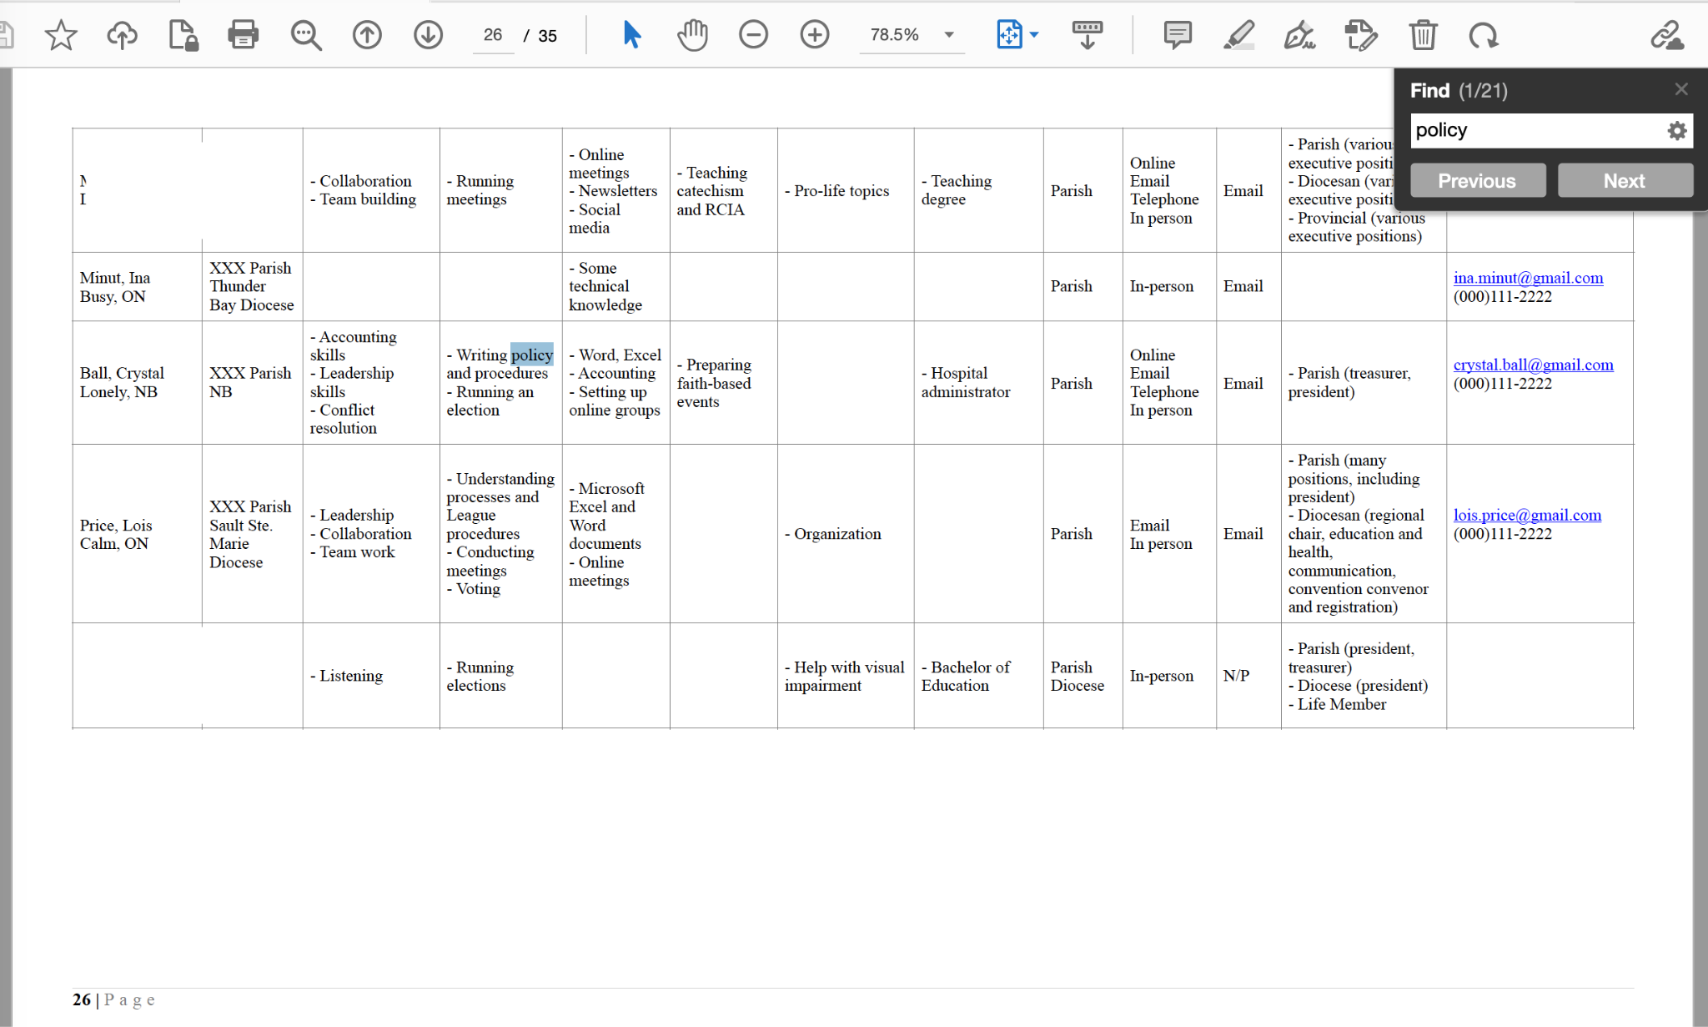
Notes:
Jacqueline:
So will Crystal Ball.

Slide 49
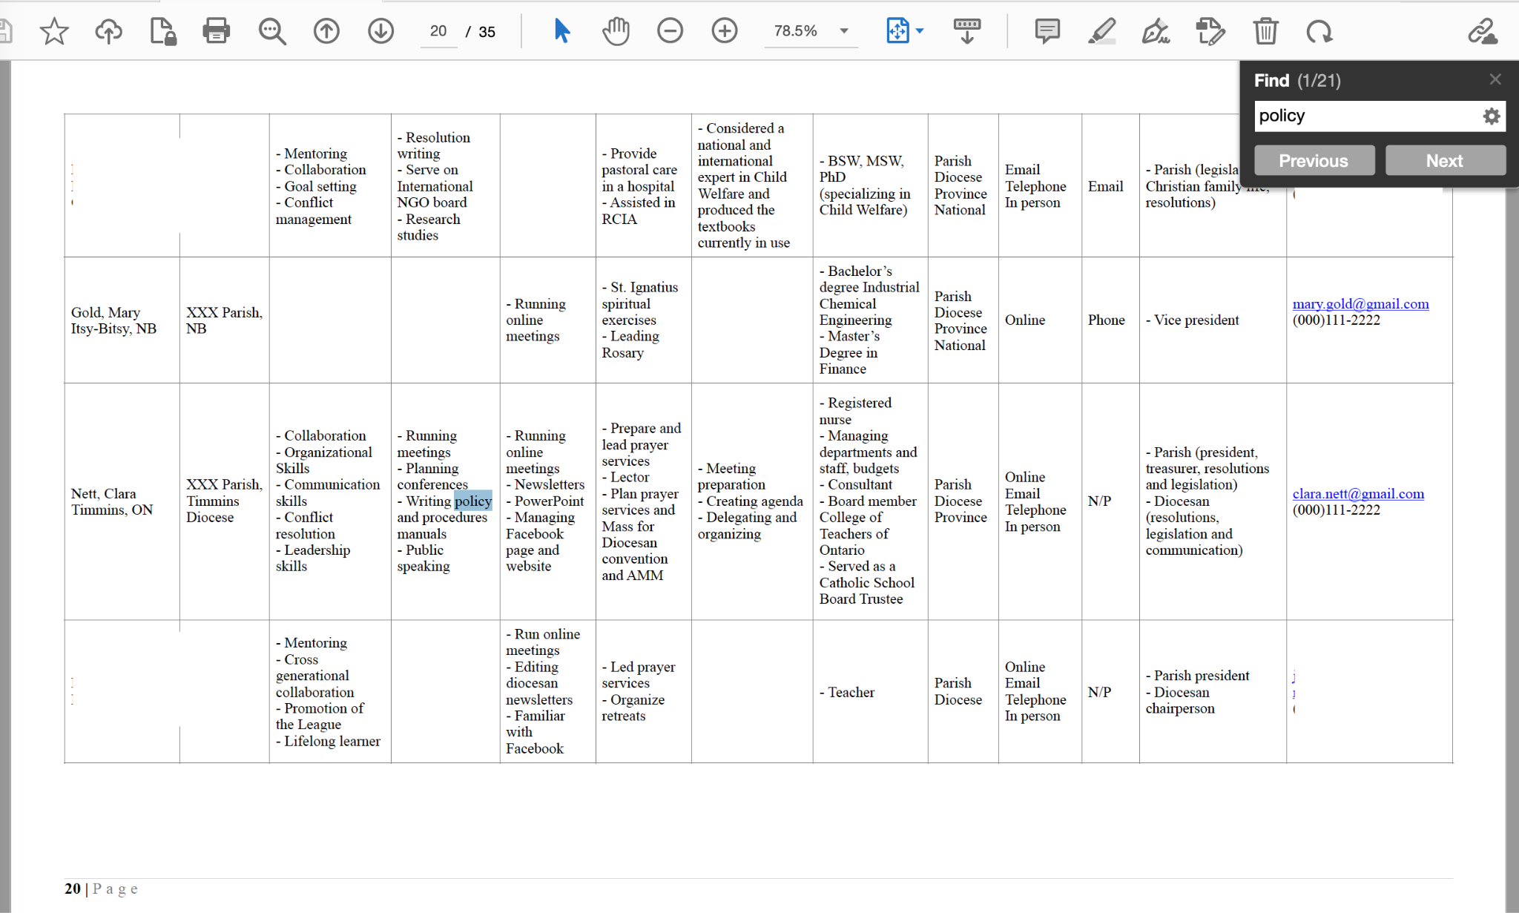
Notes:
Jacqueline:
And Clara Nett

Slide 50
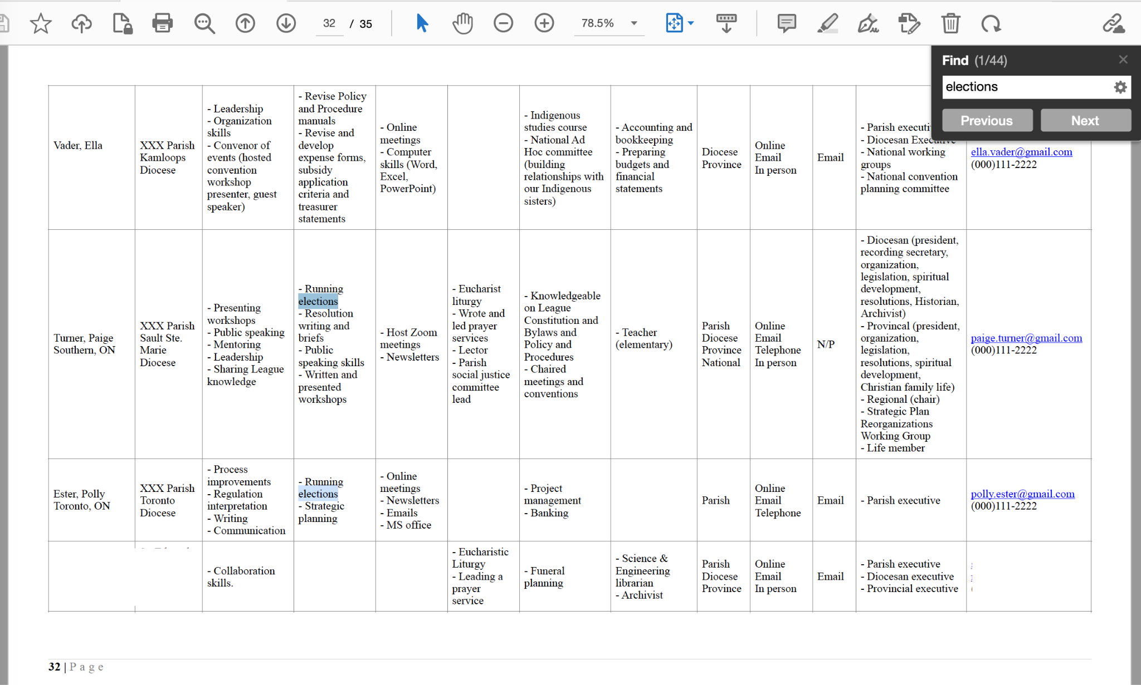
Notes:
Jacqueline:
Have you been asked to run your parish elections? Maybe you are responsible for your diocesan election for the first time. Type “elections” into the search bar and you will find many mentors willing to help. (click)
Paige Turner and (click) Polly Ester have knowledge to share.

Slide 51
Notes:
Jacqueline:
Rhoda Carr has shared that she has experience running diocesan elections.

Slide 52
Notes:
Jacqueline:
We have all been asked to create or organize prayer services at one time or another. Who hasn’t spent time stressing about that? You can see that there are 61 people that mentioned “prayer service” as a skill that they could share.
(click) This might be organizing,
(click) preparing or
(click) leading prayer services.

Slide 53
Notes:
Jacqueline:
There are lots of choices here. You can pick someone close to you (maybe even in your diocese) or someone farther away from you.

Slide 54
Notes:
Jacqueline:
And one last example - There are mentors available if you are needing help with creating or using a spreadsheet. (click) Here you can see that when I typed in “spreadsheet” only one mentor said she could help.
(click) When you look at Sue Flay’s information said she had knowledge to share about “excel spreadsheets.” The thing about searching for words/phrases is that you have to be smarter than the computer. It only searches for what you ask it to.

Slide 55
Notes:
Jacqueline:
(click) If I do a second search using the word “excel” I get 25 results instead of 1.
(click) Here we see that Terry Bell has information about Excel.
(click) But you can also see that when you search for “excel” it also finds the first 5 letters of excellent. So, once you have done a search you will need to find the person that fits what you were looking for.
The mentor members working group is very excited to have created this resource for use by all members. Hopefully, it will be released soon.

Slide 56
Education on Core Purpose and Priorities Working Group
Cecile Miller
N.E. Margaree, NS
Barbara Renaud
Maple Ridge, BC
Marjorie Robinson
Calgary, AB
Barb Thuen
Winnipeg, MB
Notes:
Jacqueline:
The Education on Core Purpose and Priorities Working Group was made up of Cecile, Barbara, Marjorie and Barb.
This group was responsible for completing two strategies:
Educate members on the core purpose of the League
Emphasize the need for education about the priorities of the League.
This group has created 3 resources that emphasize our core purpose statement and the objects of the League. These resources are still in a draft format and will be released this fall.

Slide 57
Notes:
Jacqueline:
This group has created a placemat,

Slide 58
Notes:
Jacqueline:
a bookmark

Slide 59
Notes:
Jacqueline:
and a short educational PowerPoint on the core purpose and objects of the League.

Slide 60
Redesign Criteria and Eligibility
Annette Chaplin
Deep River, ON
Jean Culliton
Teeswater, ON
Margot de la Gorgendiere
Edmonton, AB
Rebecca McCarrell
Tilbury, ON
Linda Marie O’Hagan
St. Catharines, ON
Laurel Phyall
Campbell River, BC
Francine Tournier
Duncan, BC
Notes:
Jacqueline:
The Redesign Criteria and Eligibility WG is a newly formed working group. It is made up of Annette, Jean, Margot, Rebecca, Linda Marie, Laurel, and Francine.
This group is responsible for completing two strategies:
Evaluate and possibly redesign eligibility to run for office at higher levels
Expand the criteria for eligibility for office
They have lots of work ahead of them and are ready to get started!

Slide 61
Notes:
Shari:
We have come a long way since 2018. Many women have been involved in this journey and many resources have been created. Each year the national office undertakes a survey to measure the effectiveness of the work completed and to see how close we are to achieving the strategic planning goals. Even though the work of the implementation committee is starting its last year- the work of strategic planning is an ongoing process. We have achieved some objectives and have more work to do on others.
The objective: “Increase collaboration with faith organizations and governments” has been partially achieved. Our target number for councils involved in ecumenical prayer services was 268, in 2022 294 ecumenical prayer services were held. We have achieved this portion of our objective. Our target number for engagement with government by letter, email, telephone, or in person was 1069. In 2022 it was reported that there were 863 interactions. We have more work to do in this aspect of the objective.
The we have also reached our targets with these objectives:
“Increase opportunities for spiritual development.” Our target number was 159 retreats. In 2022, 200 Spiritual retreats were held.
“Increase participation of diverse cultural groups.” In 2021 it was reported that more than 20% of the League membership is of “non-European origin.”
We are excited by how far we have come and look forward to climbing the ladder and achieving more objectives. Thank you for your time today.
(URL for photo: https://pxhere.com/en/photo/1160463)

Slide 62
QUESTIONS?
Notes:
Shari:
Questions?

Slide 63
The League of the Future
Year 5
August 2023

